Slide 1
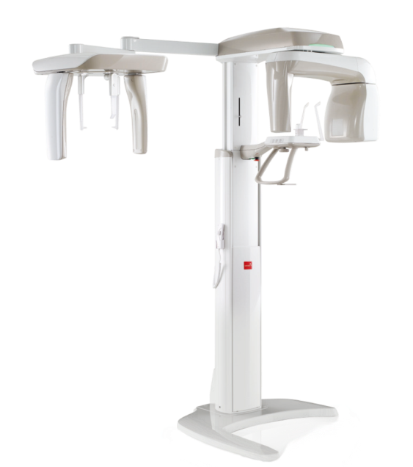


Product & System
User Guide
NEXT

Slide 2
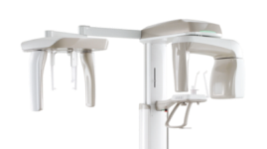
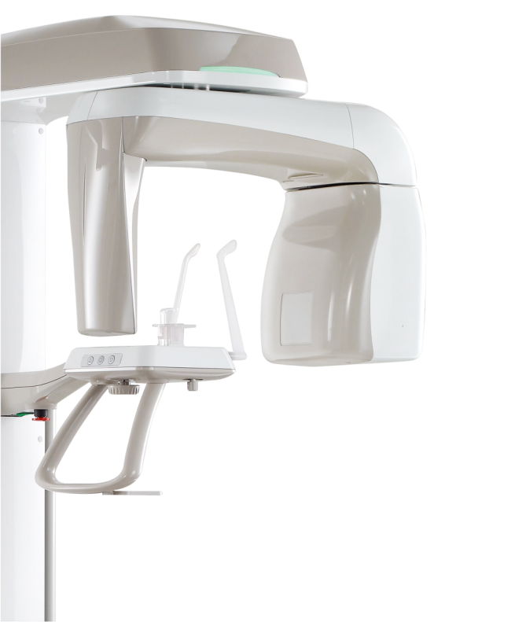

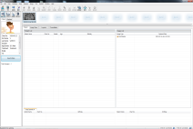


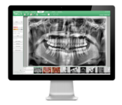



Basic
Info
Patient
Registration
Click
One Section
Image
Capturing
Procedure
Product
Management

Slide 3

Basic Info
COPYRIGHT© 2014 VATECH Global.
ALL RIGHTS RESERVED
NEXT

Slide 4
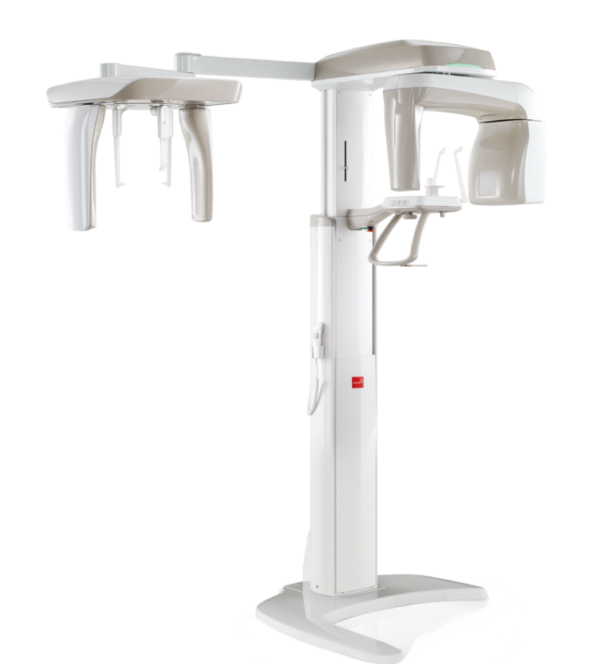
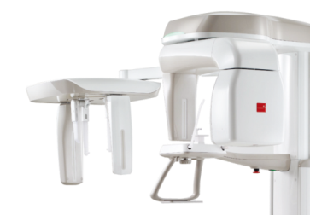

Composition & Features of the Product
2 in 1 System
Digital PANO(basic) and CEPH(option) functions combined in one device
PANO Image Algorithm of the Next Generation
PANO UDH Mode : Acquire the PANO Image with high resolution.
AF Mode (Optional) : Acquire the accurate PANO image by using the
Auto-focusing mode in the capturing area.
NEXT

Slide 5
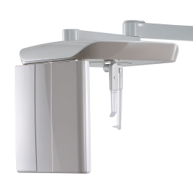
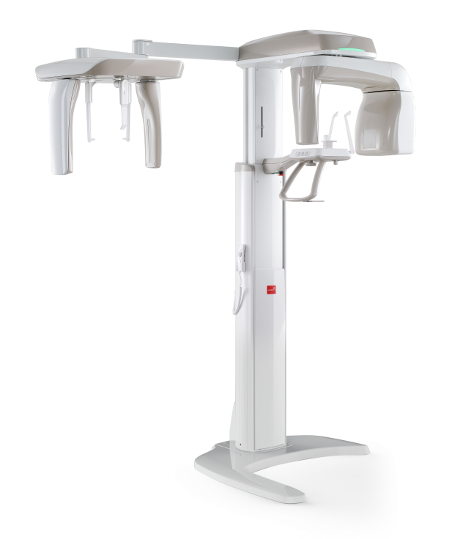
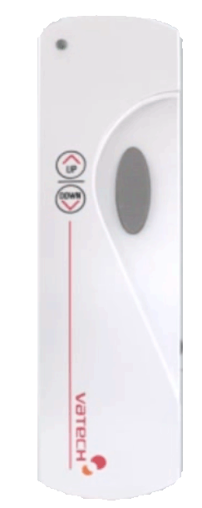

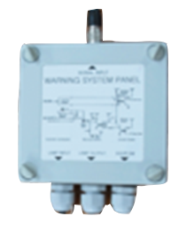
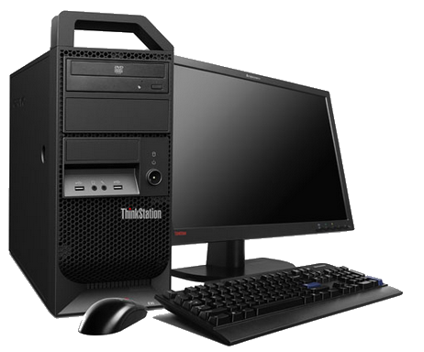

Composition of Image Acquisition System
Up/Down Switch
OneShot Ceph
Ethernet LAN Cable 10M/32.8’
Exposure Switch
Frame Grabber(LVDS) Cable 7M/23’
Ethernet LAN Cable 10M/32.8’
RS232 Serial Cable 10M/32.8’
Warning System Panel
Warning Lamp
Door Interlock
NEXT

Slide 6
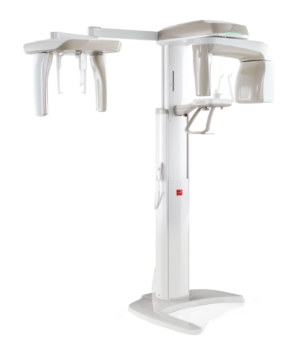
Structure, Function and Accessories of the Product
Vertical Frame
Contains main control board and the X-ray LED lamp.
CEPH Unit
Unit for acquiring the CEPH image (Optional).
Rotating Unit
Sensor and X-ray Generator rotates when capturing the PANO image.
Handle Frame
Power switch and the components needed for patient positioning.
Base
Column Unit
Base is for the support of the whole unit (Optional).
Height of the device is adjusted.
NEXT

Slide 7
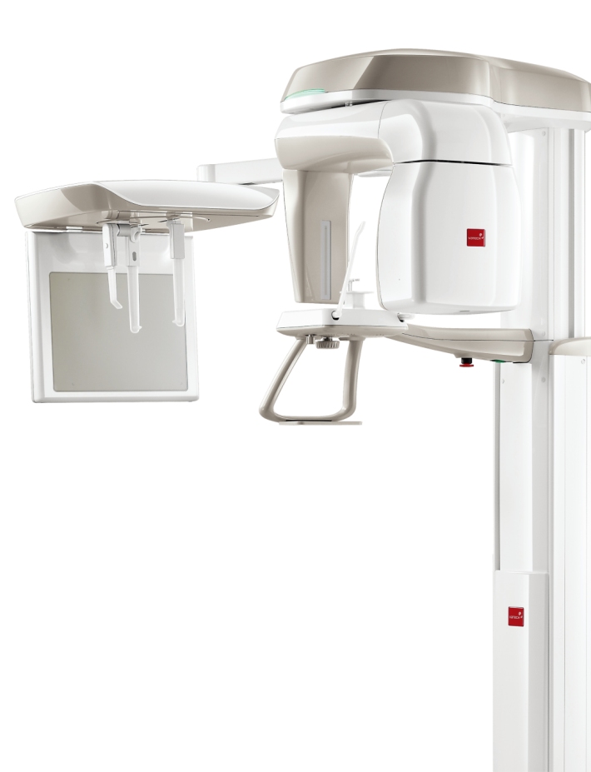
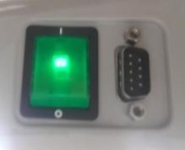
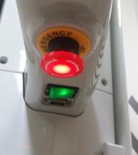
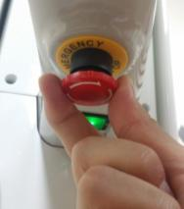
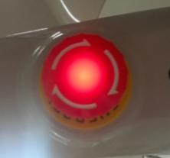
Power Switch
Turn on the switch and wait until the product initializes completely. Then, execute the Capture Software.
Emergency Switch
If any emergency situation occurs, please press the emergency switch to stop the operation of the device.
To re-operate the device, please
rotate the button clockwise, in the
direction of the arrow.
NEXT

Slide 8
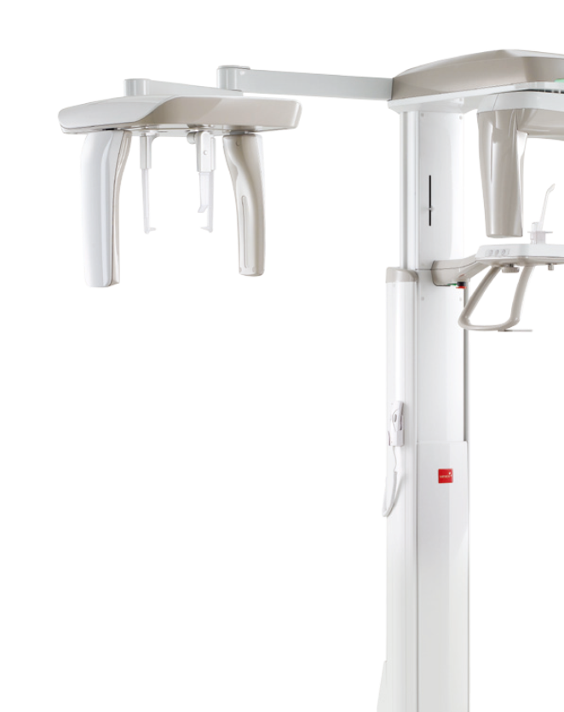
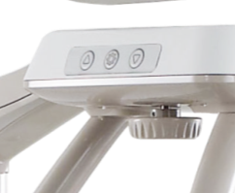


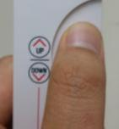
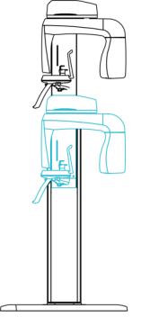
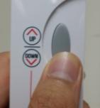
Up/Down Button
By using the Column up/down button, control the height of the column and then proceed with patient
positioning.
Column moves up by pressing the button.
Column moves down by pressing the button.
Up/Down Switch
By using the Column up/down button, control the height of the column and then proceed with patient positioning.
Column moves up when pressing the upper part of the switch and column goes down when pressing the lower part of the switch.
NEXT

Slide 9

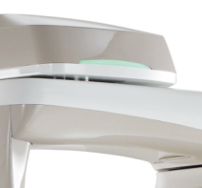

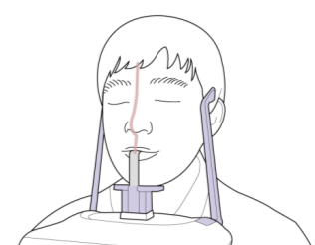
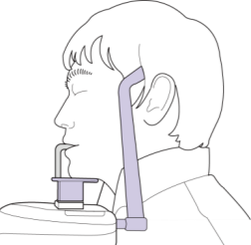
X-ray LED Lamp
If power supplies the device, the green LED light turns on and the LED light changes to orange during the X-ray exposure for image capturing.
Bite Block (Normal) & Temple Support
Place the head of the patient using the bite block and temple support for capturing the PANO image.
COPYRIGHT© 2014 VATECH Global.
ALL RIGHTS RESERVED
NEXT

Slide 10
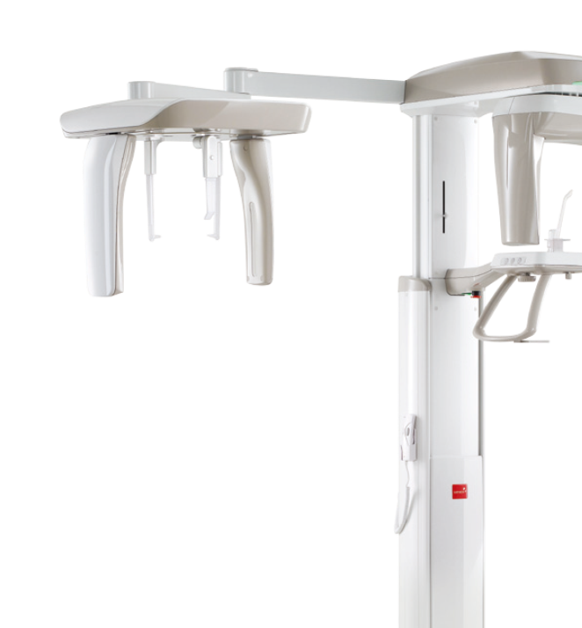
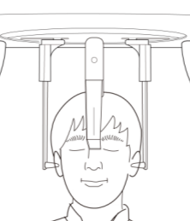
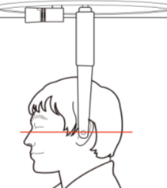
Nasal Positioner & Ear Rods
These accessories help keep the patient’s head stable and to not move when capturing the image in CEPH mode.
NEXT

Slide 11
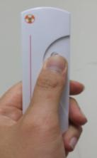
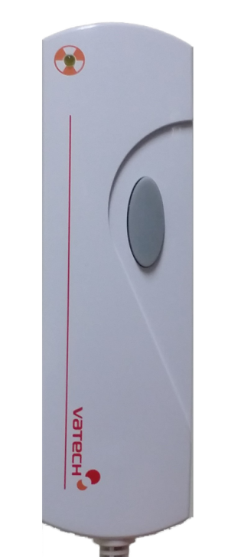
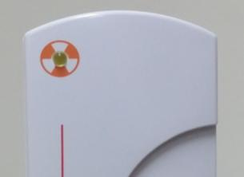
Exposure Switch
This switch is for image capturing.
The exposure switch allows the operator to control image acquisition from outside of the X-Ray room. Press and hold the exposure switch down until the acquisition is complete.
Exposure
Indicator Light
Green : Ready
Orange : X-ray ON
Exposure Button
If the exposure switch is pressed, the color of the exposure indicator light turns orange.
This indicates that there is X-Ray exposure.
NEXT

Slide 12
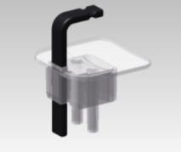
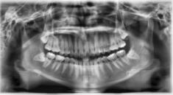
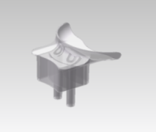
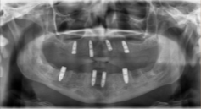
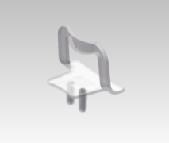
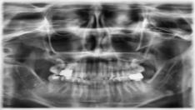
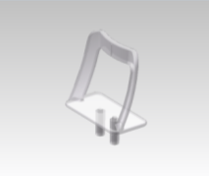
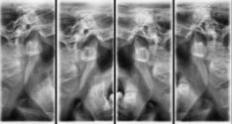
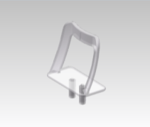
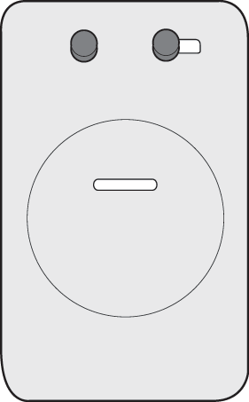
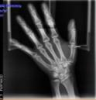
Chin Support w/ Bite Block
Capturing the basic PANO image.
Chin support : Edentulous
Chin support for edentulous patients.
Chin support: Sinus
Capturing the sinus image.
Chin support: TMJ
Capturing the TMJ Open/Close image.
Carpus Plate
Guide for capturing the carpus in CEPH mode.
NEXT

Slide 13
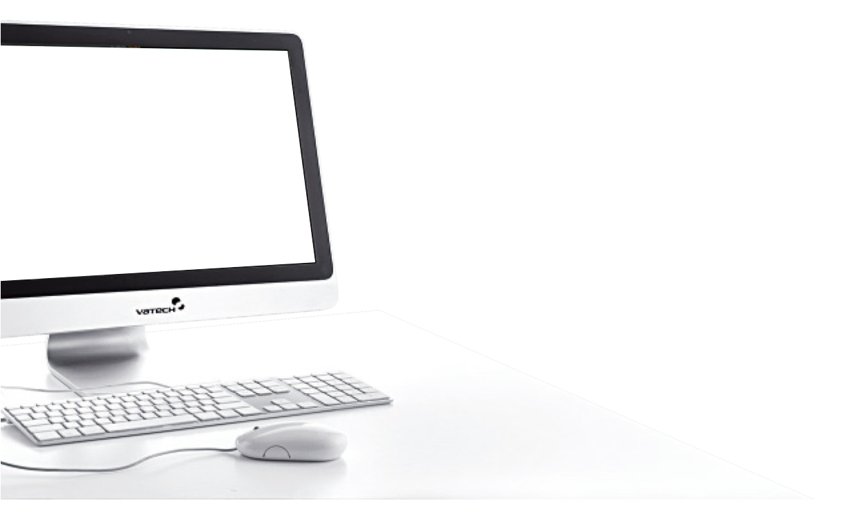
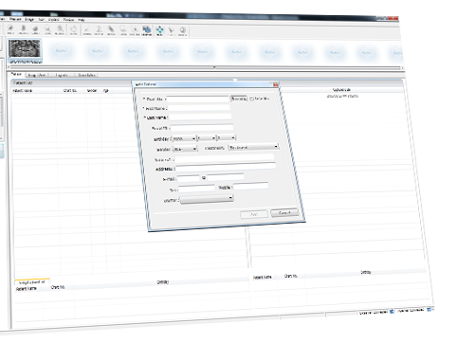
EasyDent V4
Patient Registration
NEXT

Slide 14


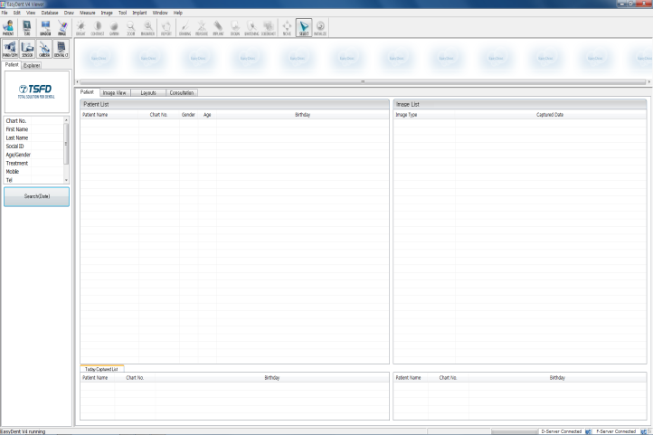



EasyDent V4
Execute the EasyDent V4 software by double clicking the EasyDent V4 icon.
EasyDent4
Viewer
Click x 2!!
NEXT

Slide 15


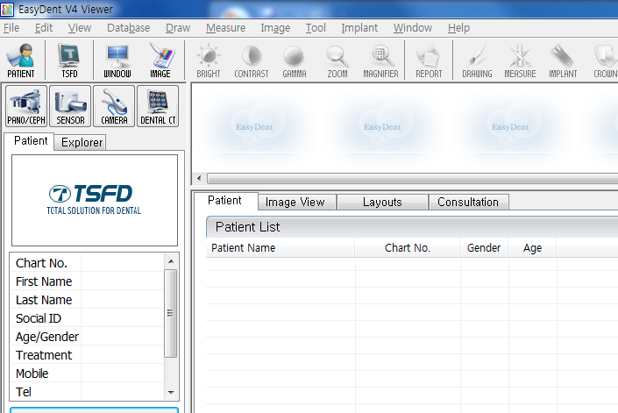

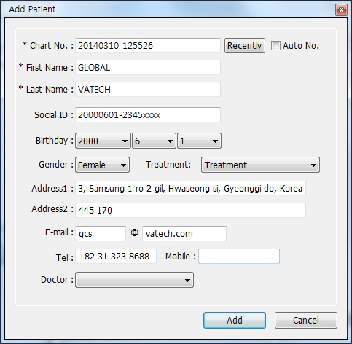

New Patient Registration
①
Click!!
Click the add patient icon. A window for registering a new patient will appear.
②
Click!!
Fill in patient information in the blanks and then click the “Add” button to complete patient registration.
NEXT

Slide 16
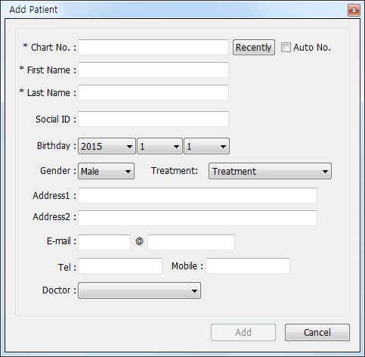
Chart No.*
First Name*
Enter the chart no. of the doctor.
The date registers automatically and you are able to cancel the set date from Settings. (Required)
Enter first name of patient.
You can change the notation order in Settings. (Required)
SSN
Last Name*
Enter last name of patient.
You can change the notation order in Settings. (Required)
Enter Social Security Number.
Date of Birth
Select the date of birth of patient.
Change the notation order from Settings.
Treatment
Select the state of treatment
Gender
Select the gender of patient.
Address
E-mail
Enter address information.
Enter information of the patient in each section.
Tel / Mobile
Enter telephone information.
NEXT

Slide 17

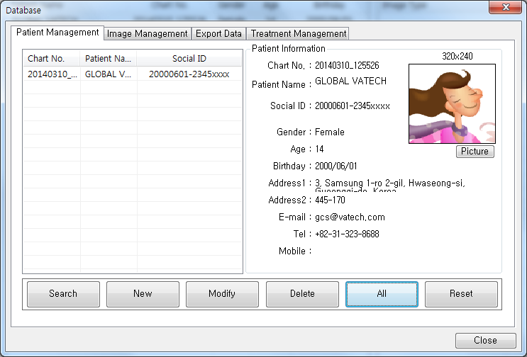




Update Patient Info.
③
Click!!
①
Click!!
④
Click!!
②
Click!!
After updating patient info., click the “Modify” button to complete the modification.
⑤
Click!!
NEXT

Slide 18





Patient Search(1/2)
②
Click!!
③
Click!!
④
Click!!
⑤
Click!!
①
Click!!
NEXT

Slide 19


Patient Search(2/2)
Double-click on Chart No., First Name or Last Name to display virtual keyboard.
①
Double Click!!
NEXT

Slide 20


How to Capture the Image
NEXT

Slide 21




Execute Capture Software (PANO)
①
Click!!
First, select a patient, click the “Panorama” button and the capture software will execute.
NEXT

Slide 22

Indicate X-ray Exposure
Mode Display
Settings & Option Button
The color of the sign turns yellow during X-ray exposure.
Displays the selected capture mode.
Choose from buttons for phantom mode, image recon and settings..
Patient Info.
Display the chart no., name, gender, age and birthday of the patient.
Capture Mode
Select image quality, capturing area and special mode.
Guide Message
Displays various directions and guidance with messages.
X-ray Exposure Condition
Select the gender or child, as well as the bone density depending on patient condition.
NEXT

Slide 23





Panoramic Image Capture Procedure
(Standard Mode)
Click buttons in the following order.
• PANO → HD → Normal → Standard
①
Click!!
Click ‘CONFIRM’ button. Then the device will
move to the patient positioning mode.
②
Click!!
NEXT

Slide 24







Panoramic Image Capture Procedure
(Patient Positioning)
Lead Apron
Tell patient to take off all jewelry and metallic objects such as hair pins, spectacles, dentures and orthodontic appliances. Place them on the accessory rack.
For safety, help patient wear the Lead Apron.
①
Click!!
②
Click!!
NEXT

Slide 25






Panoramic Image Capture Procedure
(Patient Positioning)
Hygiene Cover
Chin Support
w/ Bite Block
Mount the “Chin Support w/ Bite Block” on the Chinrest.
Cover the bite stick with the Hygiene cover.
Chin support :
Edentulous
Hygiene Cover
Hygiene covers are consumables. You are able to purchase these hygiene covers from your regional CS center.
Use this chin
support for
edentulous patients.
NEXT

Slide 26





Panoramic Image Capture Procedure
(Patient Positioning)
Follow patient procedures for proper image capture.
Grab the handle of the device tightly with two hands.
Move half step forward and let chest lean against the device.
Make sure left and right shoulders remain level and keep this position.
Patient moves to the inside of the device.
Adjust the height of the column by pressing the up/down switch (or button) until the patient‘s chin reaches the chin rest.
NEXT

Slide 27










Panoramic Image Capture Procedure
(Adjusting the Laser Beam)
Frankfurt Plane Laser Beam
Adjusting
Lever
Check if the patient bit on the groove correctly, with his/her upper and lower incisors.
Arrange the position of the patient’s head so it is level by checking the Frankfurt Plane laser beam.
①
Click!!
③
Click!!
Canine Laser Beam
Adjusting Lever
Arrange the position of the patient’s head by checking the Mid-sagittal plane laser beam
By adjusting the Canine laser beam, position the patient’s canine properly.
②
Click!!
NEXT

Slide 28




Panoramic Image Capture Procedure
(Patient Positioning - Head)
Temple Support
Wheel
Keep patient’s head stable by adjusting the temple support.
Check the Mid-sagittal plane laser beam, Frankfurt plane laser beam and the Canine laser beam again.
Notify the following instructions to the patient.
Close eyes and remain still until the scanning is completed.
Keep your tongue pressed against the palate
and breathe through the nose.
Image capture will begin.
NEXT

Slide 29












Panoramic Image Capture Procedure
(In Standard Mode)
Click the “READY” button and follow the instructions indicated on the capture software. Then complete the image capture by pressing the x-ray exposure switch.
READY
OK
NEXT

Slide 30







Panoramic Image Capture Procedure
(In Standard Mode)
After saving the acquired image, check whether it is saved in EasyDent V4 or not.
CASE #1. Basic option.
Click!!
CASE #2. In case AF or UHD option is applied.
Click!!
NEXT

Slide 31










Panoramic Image Capture Procedure
(In Bitewing Mode)
Click the buttons in the following order.
• PANO → HD→ Orthogonal → Bitewing
CONFIRM
READY
The capture procedure is the same as the standard mode in the next step.
Capture the image with the same procedure as the Bitewing Right, Bitewing Incisor, and Bitewing Left modes.
NEXT

Slide 32













Panoramic Image Capture Procedure
(In TMJ Open Mode)
Click the buttons in the following order.
• PANO → HD→ TMJ LAT Open
CONFIRM
Chin support: TMJ
READY
Capture the image with the same procedure in
TMJ PA Open/Close mode.
OK
After completion of image acquisition in the TMJ LAT Open mode, the mode switches automatically to TMJ LAT Close mode with a voice over message.
NEXT

Slide 33







Panoramic Image Capture Procedure
(In TMJ Close Mode)
Click CONFIRM.
CONFIRM
Chin support: TMJ
READY
TMJ LAT Open
SAVE
TMJ LAT Close
NEXT

Slide 34






Panoramic Image Capture Procedure
(In Sinus Mode)
Click the buttons in the following order.
• PANO → HD→ Sinus LAT
CONFIRM
Chin support: Sinus
READY
Capture procedure is the same as the standard mode in the next step .
Capture the image with the same procedure
in Sinus PA mode.
NEXT

Slide 35


Execute Capture Software
(CEPH)
①
Click!!
After selecting a patient, click the “Cephalo” button, and the capture software will execute.
NEXT

Slide 36







Cephalometric Image Capture Procedure
(In Lateral Mode)
Click the buttons in the following order.
• CEPH → Lateral
①
Click!!
(Optional)
Click CONFIRM, then the device will
turn to the patient positioning mode.
②
Click!!
NEXT

Slide 37






Cephalometric Image Capture Procedure
(Patient Positioning)
Place the ear rods to fit along the patient’s ear canals, so the patient’s head will not move during capture of the image.
Place the nasal positioner on the patient’s Nasion point.
NEXT

Slide 38








Cephalometric Image Capture Procedure
(In Lateral Mode)
Click the “READY” button and follow the instructions indicated on the capture software. Then complete the image capture by pressing the x-ray exposure switch.
READY
OK
NEXT

Slide 39










Cephalometric Image Capture Procedure
(In PA Mode)
① Select the PA mode from the
capture software and then click
CONFIRM.
② Turn the ear rods 90°
clockwise from their initial
position.
③ Widen the distance
between the two ear
rods.
④ Fold the nasal positioner.
Click!!
⑦ After saving the acquired image,
check whether it is saved in
EzDent-i or not.
⑥ Click READY from the
capture software and proceed to
the image capture.
⑤ Ask the patient to stand upright
facing the sensor. Make sure
that the patient’s shoulders are
level and his/her neck is
relaxed.
NEXT

Slide 40




Cephalometric Image Capture Procedure
(In SMV Mode)
① Select the SMV mode from
the capture software and
click CONFIRM.
② Turn the ear rods 90°
clockwise from their
initial position.
③ Widen the distance
between the two ear
rods.
④ Fold the nasal positioner.
Click!!
⑦ After saving the acquired image,
check whether it is saved in
EzDent-i or not.
⑥ Click READY from the
capture software and proceed
the image capture.
⑤ Gently bend the patient’s head
back until his/her Frankfurt
plane is perpendicular to the
floor as shown in image above.
NEXT

Slide 41




Cephalometric Image Capture Procedure
(In Waters View Mode)
① Select the Waters View mode
from the capture software and
click CONFIRM.
② Turn the ear rods 90°
clockwise from their
initial position.
③ Widen the distance
between the two ear
rods.
④ Fold the nasal positioner
Click!!
⑦ After saving the acquired image,
check whether it is saved in
EzDent-i or not.
⑥ Click READY from the
capture software and proceed
the image capture.
⑤ Ask the patient to stand upright
facing the sensor and bend
his/her neck back about 35° - 40°.
NEXT

Slide 42





Cephalometric Image Capture Procedure
(In CARPUS Mode)
① Select the Carpus mode from
the capture software and
click CONFIRM.
② Turn the ear rods 90°
clockwise from their
initial position.
③ Slide the CARPUS
Plate onto the nasal
positioner.
④ Slide the locking bolt on
the CARPUS plate towards
the nasal positioner and
turn it to the left.
Click!!
⑦ After saving the acquired image,
check whether it is saved in
EzDent-i or not.
⑥ Click READY from the
capture software and proceed
the image capture.
⑤ Ask the patient to put his/her right
hand flat on the CARPUS plate.
NEXT

Slide 43
Product Management
NEXT

Slide 44

Emergency Treatment
If any problem occurs while operating the device, perform the corresponding troubleshooting measures outlined in the table below. If the problem persists, please contact customer service.
CASE #1. Device Not Operating
CAUSE | SOLUTION
Fail to supply power | Check the power cable and the connection status.
Problem initializing | Initialize the device completely and then try to operate again.
Fail in communication between PC & Unit | Check the connection status of serial port(RS232) which connects the PC to the device.
CASE #2. X-ray Exposure Switch
CAUSE | SOLUTION
Without pressing the “Ready” button | Check if the unit is completely ready for image capture from the capture software.
NEXT

Slide 45
Emergency Treatment
CASE #3. Problem in Image Capturing
CAUSE | SOLUTION
Fail in device initialization | Re-start to capture image after initialization of the unit. If this happens continuously, restart the unit and try again.
CASE #4. Problem in Patient Positioning – Laser Beam Off Issue
CAUSE | SOLUTION
Exceed the time limit for patient positioning | Turn the laser beam on again and proceed to patient positioning. Click the laser beam button from the unit or capture software, then three laser beams will turn on.
NEXT

Slide 46
Cleaning
Before cleaning the device, make sure that the power of the device has been turned
off completely and disconnect the power plug from the outlet.
▣ ATTENTION
  Please keep the device clean, especially the part where the patient touches or has contact with often such as the handle frame, chin support and the bite blocks.
  Do not use the spray cleaners or solvents to clean the device. It may cause damage on the electrical components.
  Do not use abrasive liquids such as acetone, gas, or oil.
  It may cause corrosion of the device’s surface.
  Do not use cleaning products which contain silicon.
  It may cause damage on the electrical components.
NEXT

Slide 47
Cleaning
▣ HOW TO CLEAN
ACCESSORIES | HOW TO CLEAN
Bite Block | Before capturing the image of each patient, sterilize these accessories with alcohol and dry off with a soft cloth.
Temple Support
Chin Support (Normal / Sinus / TMJ)
All components that are in physical contact with the patient and the operator
PC and Peripheral Devices | Clean and keep them in good condition.
Outer part of the Device | Wipe the outer part of the unit with a soft dry cloth everyday. Do not use any cleaners, bleaches or solvents for cleaning.
NEXT

Slide 48
Maintenance
Before inspection, ensure that the power of the device is turned off.
Do not open the cover of the device.
For the prevention of fire, please use the same fuse when replacing.
▣ ATTENTION
  Do not unplug the power plug with force.
  Do not keep the device and parts in a humid place.
  Keep the device and parts in an appropriate place to maintain them
  in a good condition. They may be influenced by environmental factors such
  as temperature, lights, ventilation, dust, salt and etc.
  For items needed for image capturing, please arrange them and put them in proper places for the next image capture.
  Please check the ground connection of the device.
  Do not try to fix the device(including wires and cables) by yourself.
  This may cause accidents and damage to the device.
NEXT

Slide 49
Maintenance
▣ Tasks for Maintenance
CHECK LIST | Period
Before using the device, ensure that the device is clean and ready for use. Also, check the cleanliness of the areas where the patient is in contact with often. | Daily
After using the device, make sure that the main power of the switch has been turned off. | Daily
Ensure that the device is firmly plugged into a power supply device, which is available only for the device. | Daily
Ensure that the power plug of the device is not unusually over heated. | Daily
While pressing the exposure switch (during X-ray exposure), please make sure that the indicator light turns on properly and remains orange, indicating there is no problem. | Daily
Check the proper operation of the x-ray exposure switch. | Daily
Check the status of the power cable. Ensure that there are no scratches or damage. | Weekly
Ensure that there is no problem with the operation of the emergency button. Entire operation of the device should stop if the emergency button is pressed. | Weekly
Ensure that all the labels attached on the device are clearly visible. | Monthly
Ensure that the voice over messages are audible during X-Ray exposure. | Monthly
NEXT

Slide 50
Disposing Unit
How To Handle & Dispose Material
Classification | Main Material | Reusable | Special Treatment Needed (Mandatory) | Hazardous Waste (Needs to be handled separately)
Frame & Outer Cover | Aluminum & Plastic | ●
Motors |  | ●
Circuit boards |  | ●
Cable & Transformer | Copper | ●
 | Iron | ●
 | Oil |  | ●
Packing | Wood | ●
 | Cardboard | ●
 | Paper | ●
X-Ray Tube |  |  |  | ●
Sensor Head | Please return these parts to the manufacturer, Vatech.
Other Parts |  |  | ●
To reduce environmental contamination, this dental x-ray device should be disposed of by following these instructions. All parts and components which contain hazardous materials must be disposed of in accordance with the disposal regulations.
Except the X-Ray tube, all other parts are re-usable. (IEC 60601-1 6.8.2 j).
Please observe all regulations
relevant to the disposal of waste in
your country. For further
information regarding device
disposal, please inquire at your
customer service center.
This dental X-ray device must
not be disposed of as regular
garbage.
Please clean, disinfect and sterilize
the device before disassembling
and disposing of its parts.

Slide 51
Thank you
FAQ

