Slide 1
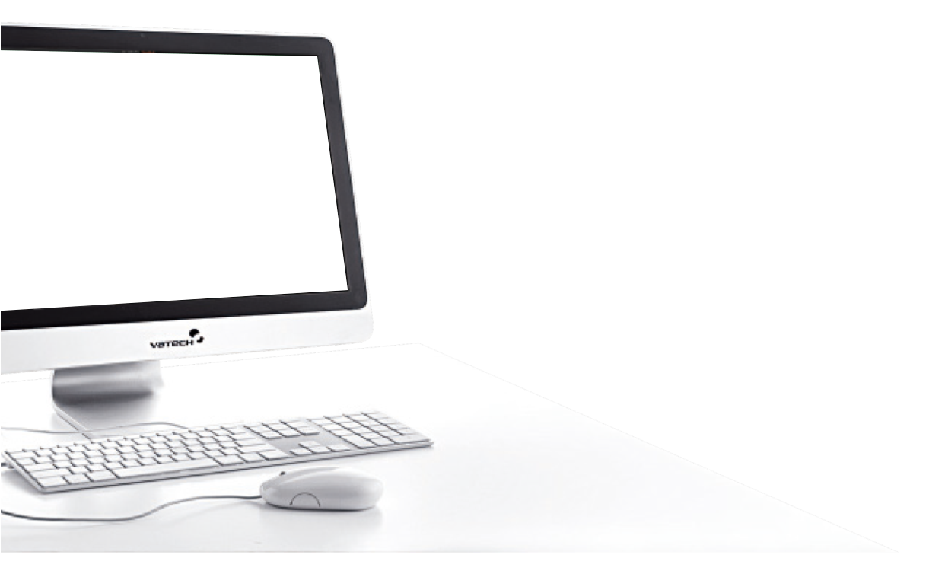
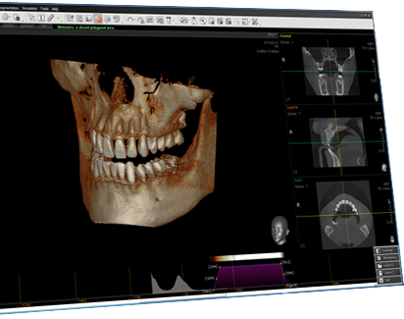

NEXT
plus
How To Use The Functions

Slide 2




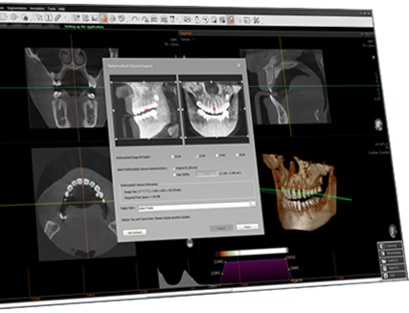
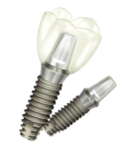
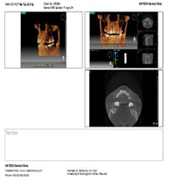
NEXT
Ez3D-plus
Basic Functions
Implant Simulation
Print & Report

Slide 3
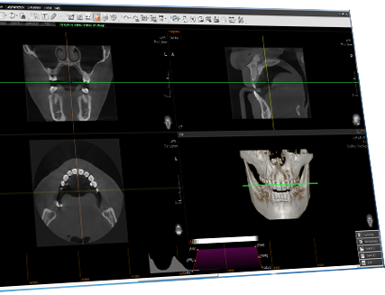

NEXT
plus
Basic Functions

Slide 4

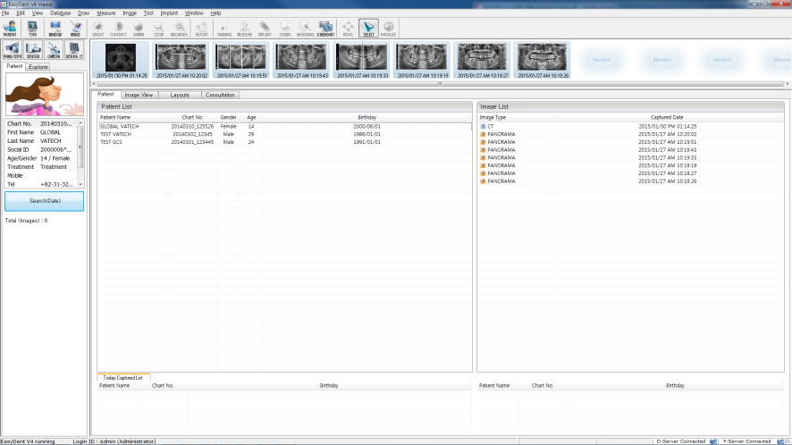
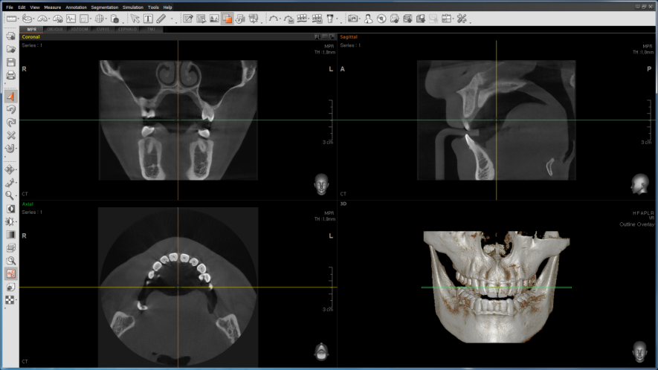

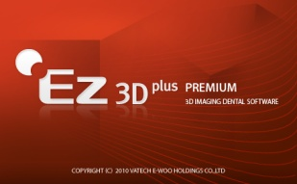

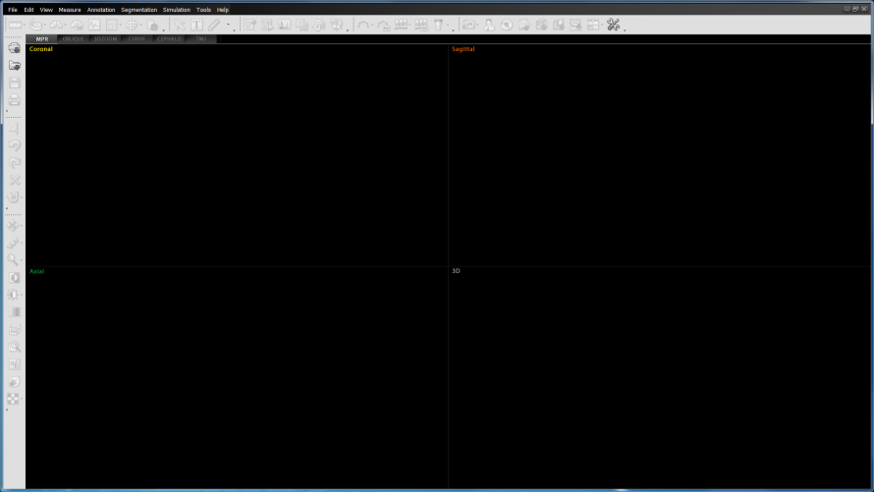
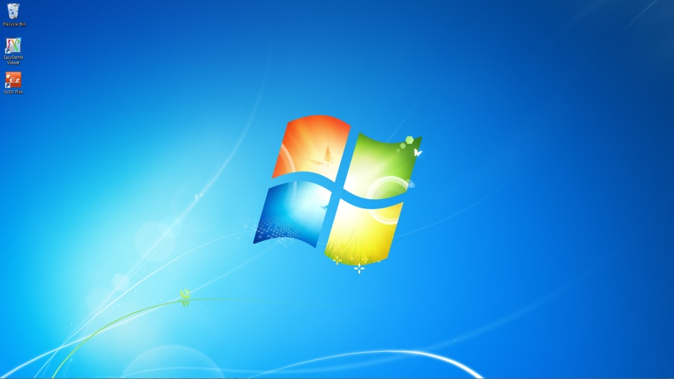


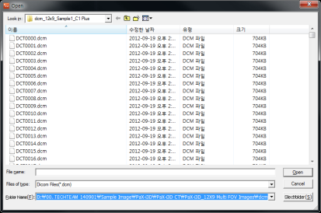
Start Ez3D-plus from EasyDent4
NEXT
①
Click x 2!!
Start Ez3D-plus from the Desktop
①
Click!!
②
Click!!
①
Click x 2!!
③
Click!!

Slide 5

Main Screen
NEXT
Menu Bar
View Mode
All functions of Ez3D plus are provided in a pull down menu classified by category.
View Mode consists of MPR, Oblique, 3D Zoom, Curve, Cephalo, and TMJ Mode.
Tool Bar
The tool bar provides the user with the most commonly used tools among the menu functions.

Slide 6
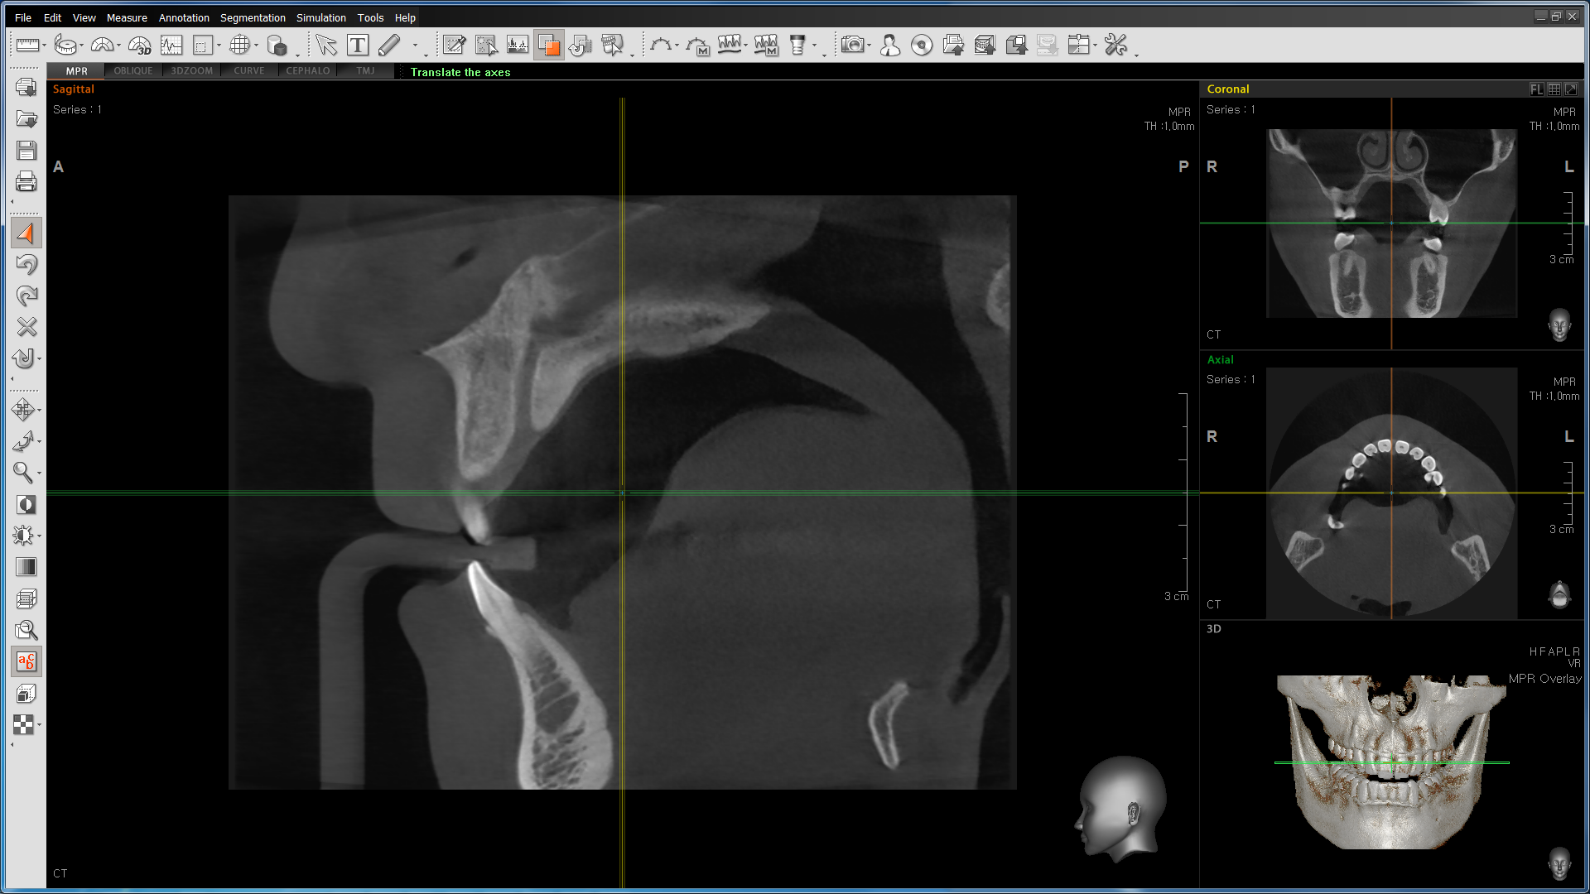
Main Window - MPR
NEXT
Patient
Information
Title Bar
Image View
Sub Tools
The title bar represents the direction of the current cross sectional image being displayed.
User can flip, enter Multi-Slice
View, and Maximize the image.
ID : 20140315_0001
Mary Jane [W] 27
19880527
Series : 999
7.4 [mA]
90.0 [kVp]
CT
Grid
Directional
Information
Guide for patient orientation
Indicates the length of a marked area.
Displays image capture information like mA and
kVp at the time of when image was taken.
Guide for patient orientation
Indicates the direction of an image.

Slide 7
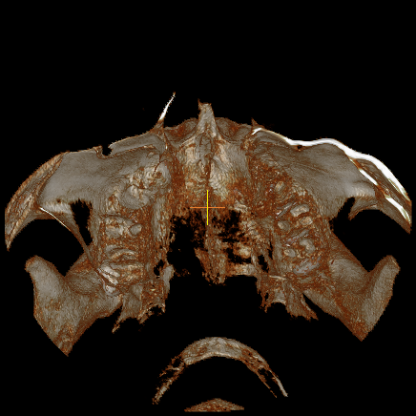
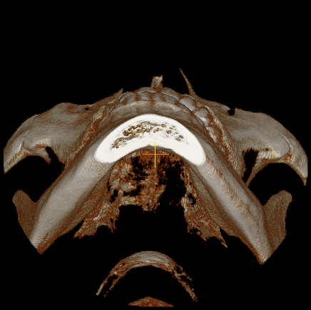
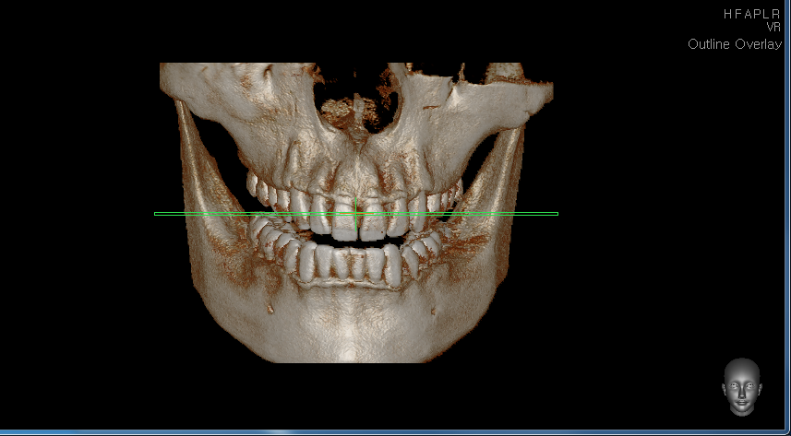
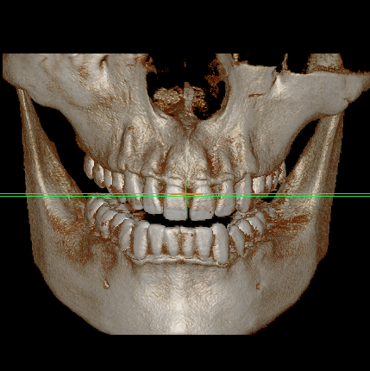
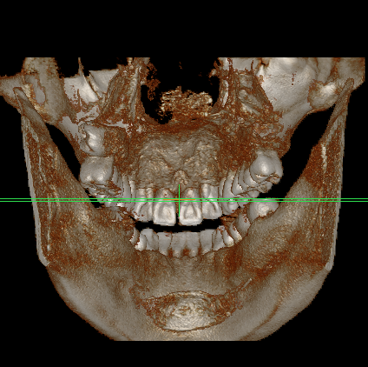
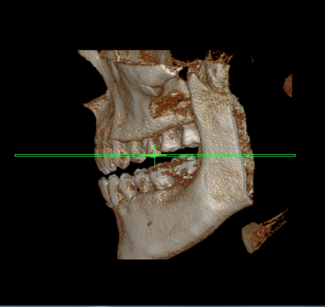
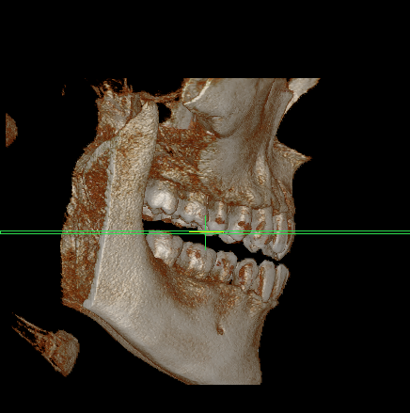
Main Window - 3D
NEXT
H
F
HFAPLR
A
P
3D Image Direction Initialization
H
F
A
P
L
R
Reset To Head View
Reset To Foot View
Reset To Anterior View
Reset To Posterior View
Reset to Left View
Reset To Right
L
R

Slide 8















Description of Tools (1/3)
NEXT
Length
Measure the length between two
points in the image.
Note
Add memo in the image.
Tapeline
Measure the length between two
points in the image.
Free Draw
Perform drawing in the image.
2D Angle
Measure angle in 2D image.
Polygon
Draw polygon and partition
the image.
3D Angle
Measure angle in 3D image.
Opacity
Specify opacity value and partition
the image.
Profile
Measure bone density between two
points in the image.
Threshold
Specify threshold value and partition
the image.
ROI
Measure bone density of selected area.
Apply Mask
Apply the performance result of
Segmentation to Axial, Sagittal and
Coronal image.
Area
Measure the size of selected area.
Reset Mask
Reset all sculpted or masked anatomy.
Volume
Show the volume information of selected area.
Maxillary
/Mandible
Automatically separate the Maxillary
and Mandible areas of the 3D image.
Arrow
Draw an arrow in the image.
Manual
Curve
Draw curve and show Panorama View.

Slide 9













Description of Tools (2/3)
NEXT
Curve
Manager
Save and manage the curve.
Memory
Export
Export the patient’s data using CD, etc.
Draw Canal
Draw canal.
STL
Export
Enable the Volume data, which makes up the 3D image, to form a mesh data (STL file) that can be uploaded to other 3D Viewers.
Draw Canal
Draw canal manually.
Export:
Reformatted
Volume
Export the reformatted volume.
Insert
Implant
Insert single implant.
Panorama
Import
Import a panoramic image from EasyDent4.
Capture
Save image pane/whole image
as image file.
Fine Tuning
Adjust 3D image.
Counsel
Prepare a report on simple image
analysis and treatment planning.
Setting
Manage settings of the program.
CD/DVD
Burning
Save current image/case to CD/DVD.

Slide 10















Description of Tools (3/3)
NEXT
Select
Initialize the mouse function.
Invert
Invert color and brightness of
all images.
Undo
Revert to previous state.
Windowing
Adjust the brightness and contrast.
Redo
Restore back to previously canceled
work.
Coloring
Adjust coloring of the image.
Delete
Delete the tools for measure
annotation.
Oblique
Show the cross sectional view of
selected image from image pane.
Select
Return to initial status of image.
3D Zoom
Enlarge/reduce 3D image of
selected area.
Panning
Move the image up/down and
left/right.
Study Info
Show/hide patient’s information.
Rotating
Rotates an image
two-dimensionally.
VOI
Show volume information of
selected area.
Zooming
Zoom in/out on image.
Apply Filter
Provide three different filters to
2D image: smooth, sharpen and
unsharpen (sharpen more).

Slide 11
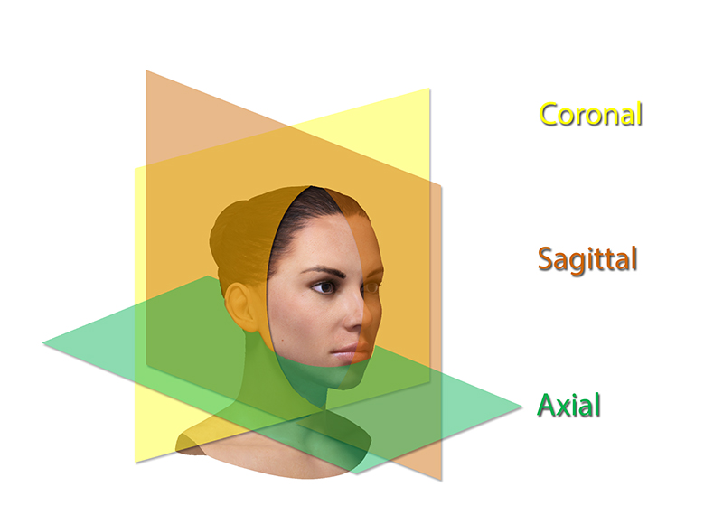

Adjust the Axis of the 2D Image(1/2)
NEXT
Coronal - The yellow slice is the vertical cross-section viewed from the front.
Sagittal - The orange slice is the vertical cross-section viewed laterally.
Axial – The green slice is the horizontal cross-section viewed from bottom to top.
Coronal
Sagittal
Axial

Slide 12
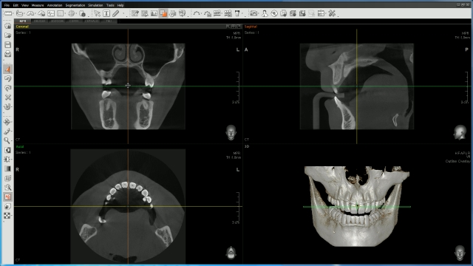
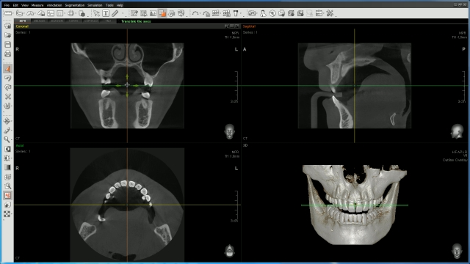
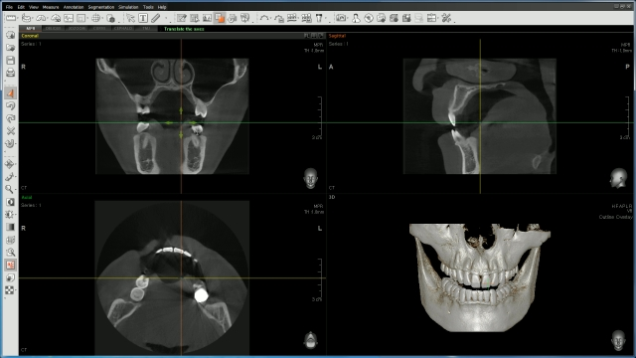
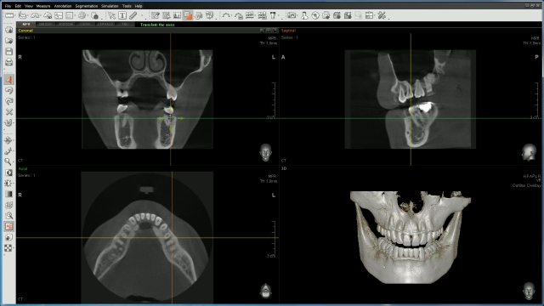


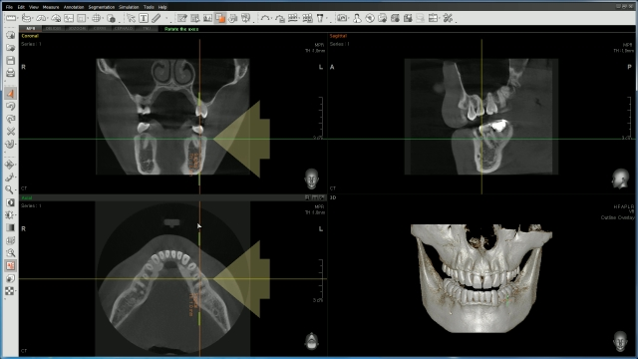

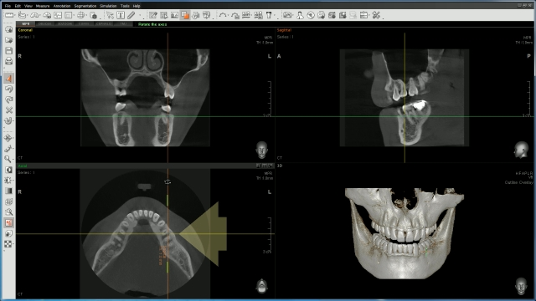
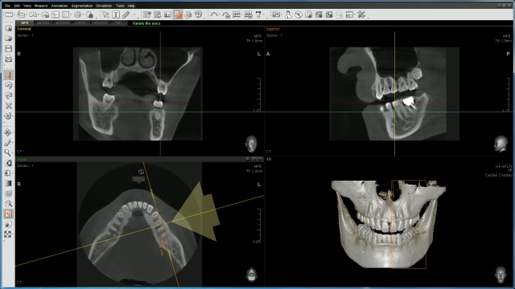
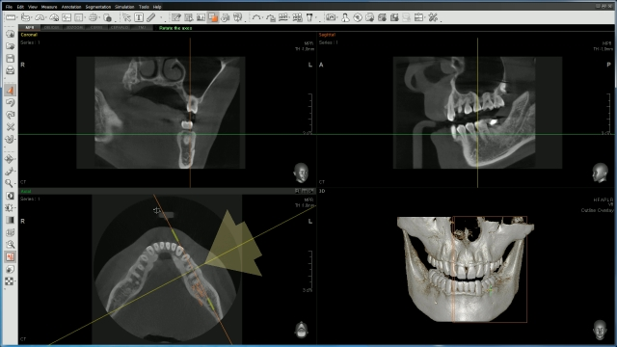
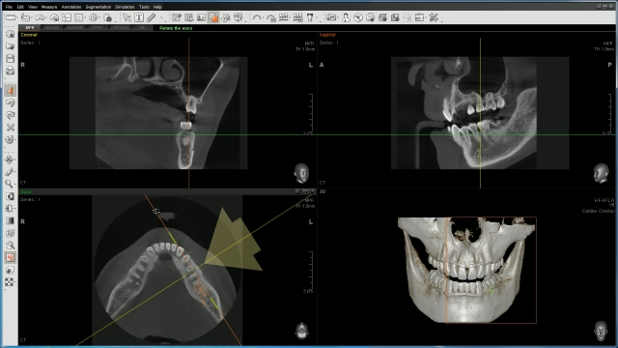
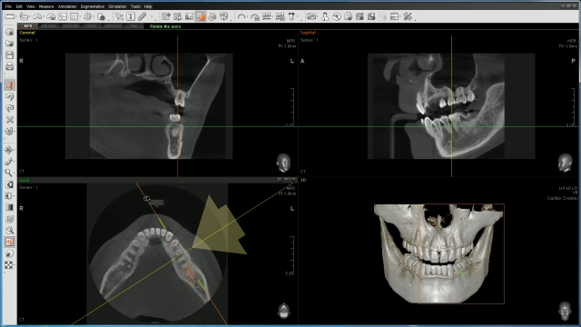

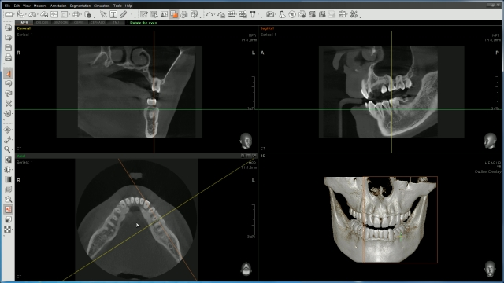

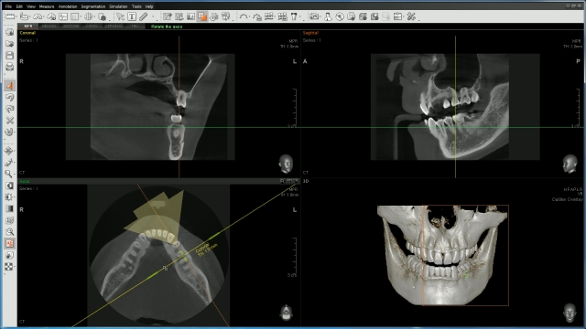

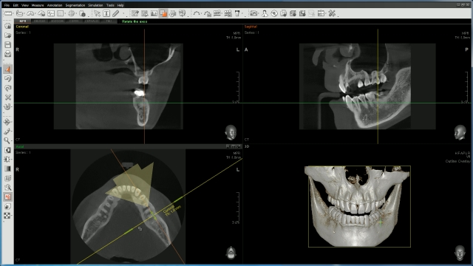
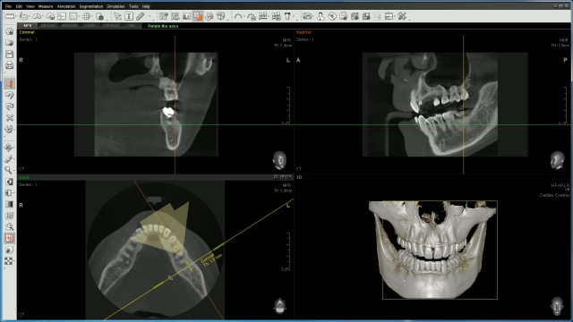

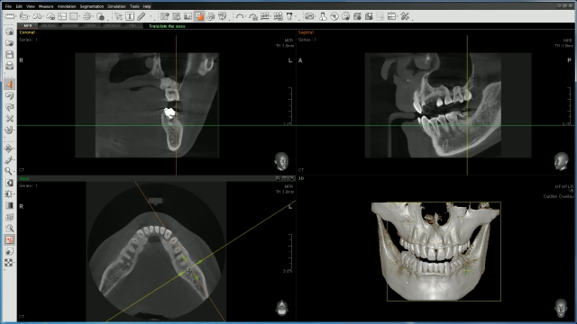

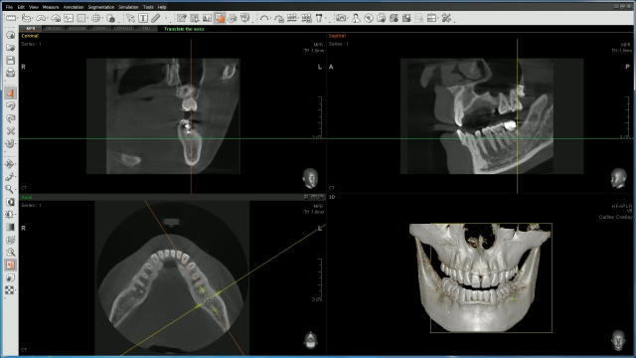


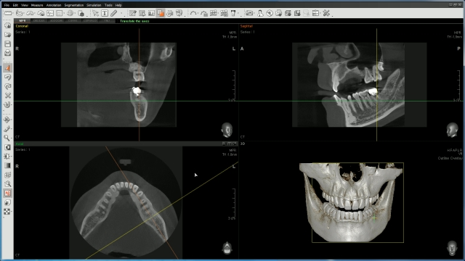


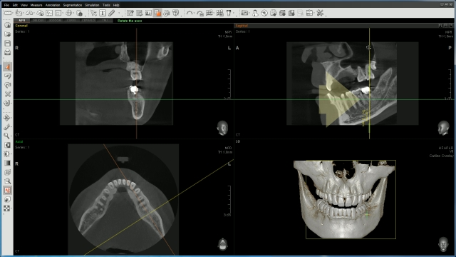

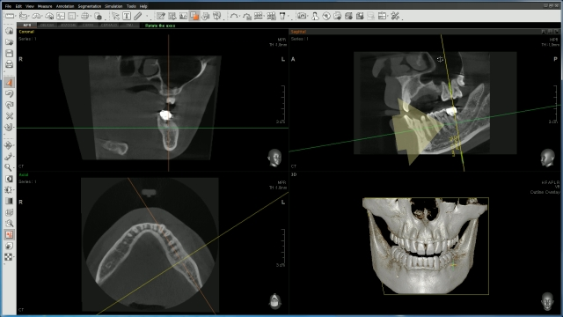
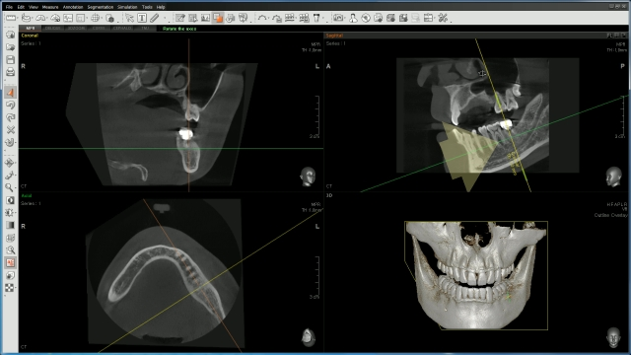
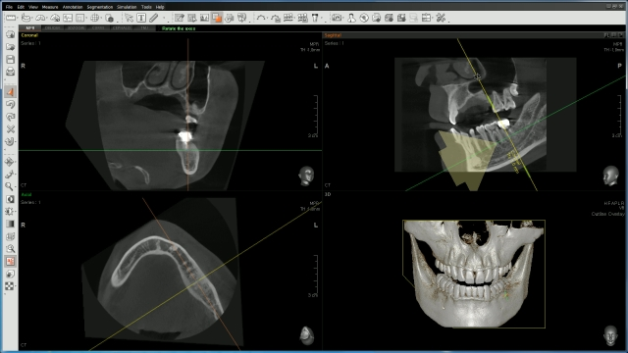



Adjust the Axis of the 2D Image(1/2)
NEXT
① Adjust Two Axes Simultaneously
Place the mouse cursor to the point where two axes intersect, the cross cursor will appear.
② Adjust One Axis
Place the mouse cursor on one axis. Then click and drag to move the axis of the selected tooth.
③ Rotate the Axis
Place the mouse cursor on an end point of the axis. Then click and drag to adjust the axial direction of the selected tooth.
Play
2
3
1
2
3

Slide 13
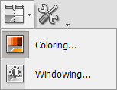
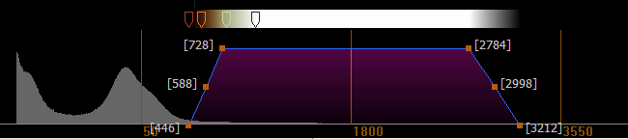
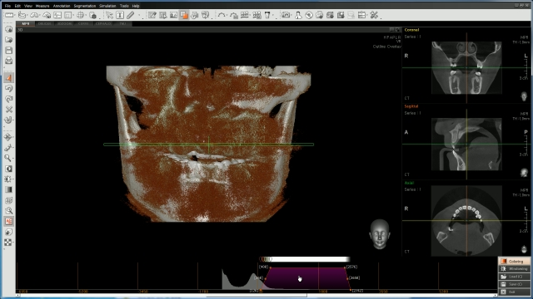


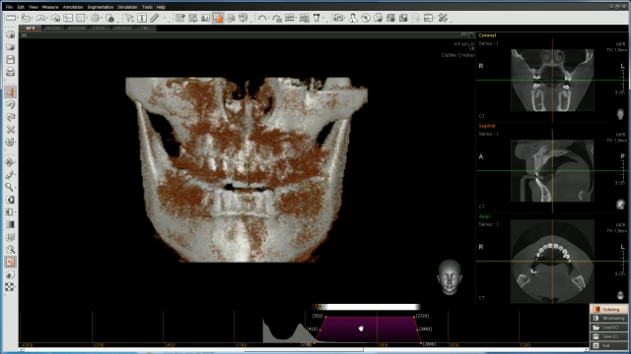
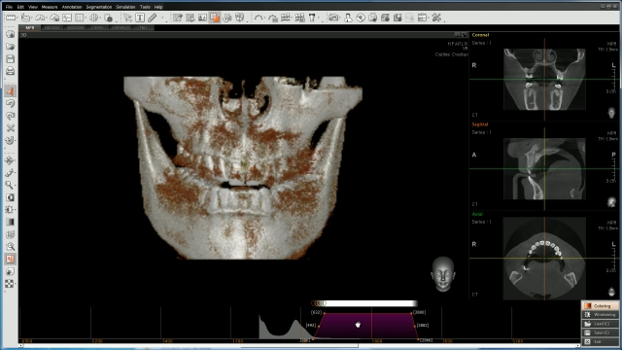
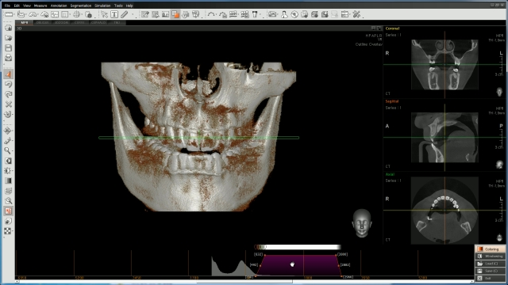

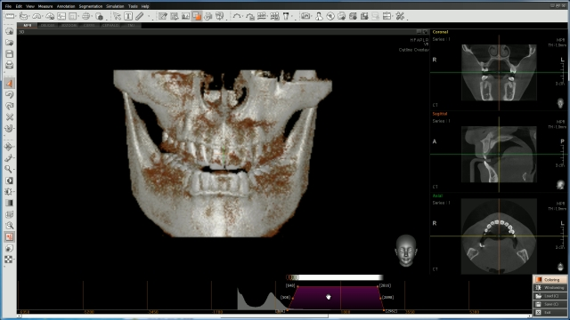





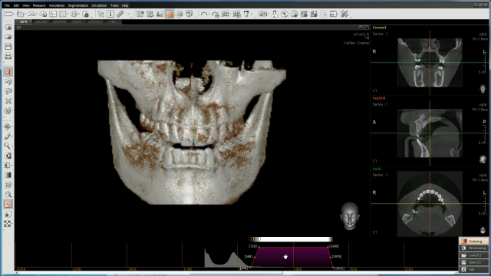







































Adjust the Fine Tuning
NEXT
① On the menu bar, click Tools → Fine Tuning.
② Click Coloring, the coloring control panel
will appear.
①
Click!!
②
Click!!
Play
Fine tuning adjustments include:
1. density segmentation
color range
opacity

Slide 14



















































































Length
NEXT
Measure the distance between two selected points in [mm] on the image.
① On the menu bar, click Measure → Length or click the
Length icon from the measure tool bar.
② Two sub tools will appear, as shown in image below.
2D will display the measurement on the current 2D
window.
③ Click the two points to measure distance between start
and end point.
Play

Slide 15



























Profile
NEXT
① On the menu bar, click Measure → Profile or
click the Profile icon in the measure tool bar.
② Select two points between start and end points.
Play

Slide 16


















































ROI – Region of Interest
NEXT
This tool provides the user with statistics on a specific region of interest.
① Click Measure → ROI or click the ROI icon on the
measure tool bar.
② Two sub tools will appear.
③ Point and click on the initial point and drag to expand the
area, then click on the second point.
Play

Slide 17
















































































Oblique
NEXT
Oblique View is for viewing the cross sectional image of a specific area in an MPR view window.
① Click View → Oblique, or click the Oblique icon on the View tool bar.
② Click on the area within the image.
③ Then move the mouse to desired size and click once again.
④ The View mode will be converted to Oblique mode on the screen.
In Oblique mode, users can modify the size of the view area, center pan, change view direction, and/or adjust thickness.
Play

Slide 18




Memo - Note
NEXT
①
Click!!
To input a note on the image, click on the desired area.
A dialog box will appear.
① On the menu bar, click Annotation → Note, or click the
Note icon on the Annotation tool bar.
Play
This is note for memo.
And it is possible to save each patient.
②
Click!!

Slide 19



























































Free Draw
NEXT
The Free Draw function can be utilized for both representations and patient consultations. You can use this feature via a mouse or an electronic pen.
① On the menu bar, click Annotation → Free Draw, or click
the Free Draw icon on the Annotation tool bar.
Play

Slide 20
NEXT
plus
Implant Simulation

Slide 21





































Cross-Sectional
NEXT
① Click the ‘Panoramic Curve’ button and then
click the ‘Manual’ button.
Click!!
② Draw the Panoramic Curve.
Play
Click!!
Click x 2!!

Slide 22














































Canal Drawing
NEXT
① Click the ‘Draw Canal’ button and then
click the ‘Manual’ button.
Click!!
② Draw the Canal.
Play
Click!!
Click x 2!!

Slide 23




































































Implant Simulation
NEXT
① Click ‘Implant Simulation’ and then ‘Insert
Single Implant’.
Click!!
Play
② Select an Implant from the Implant
Library and click “insert”.
Click!!

Slide 24


NEXT
plus
Print & Report

Slide 25



Print - Window
NEXT
①
Click!!
Selection
Print menu changes according
to the view mode created
in Ez3D plus.
Print info
Print Icon
on the Tool bar
Input the user information,
clinic, doctor-in-charge, and
header and footer information
for printing.
Invert Image
When this box is checked,
only the image will be inverted
Calibration
To prevent incorrect scales on
the image, this function
calibrates them to the correct
scale with a test print page.
Print Setup
Modify paper layout and
direction.
Page Setup
Setup a basic print layout form.

Slide 26


Print - DICOM
NEXT
①
Click!!
②
Click!!
① Click to File → Print. Print window pop up will appear.
② Click DICOM Tab on the print window.
③ Click ‘Print’ button on the print window.
④ Now Sending window pop up will appear.
Now Sending
③
Click!!

Slide 27






Print - Report
NEXT
①
Click!!
②
Click!!
① Click to File → Print. Popup the print window
② Click to Report Tab on the print window
③ Click to Template icon. Popup the template window
④ Select which is using a form
⑤ Appear the selected form.
Adding the image from Ez3D Plus
⑥ Click to Next button if finished to make the report.
⑦
Click x 2!!
⑥
Click!!
④
Click!!
③
Click!!
⑤
Click!!
⑧
Click!!

Slide 28
Thank you
FAQ

