Slide 1
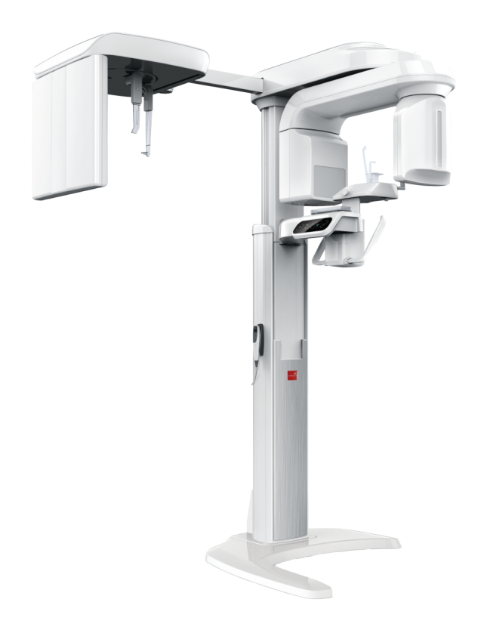


NEXT
Product & System
User Guide

Slide 2
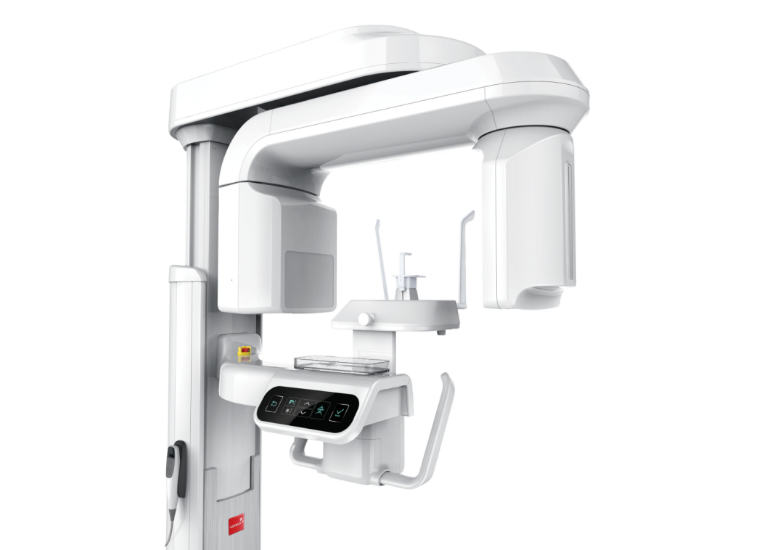
NEXT
Basic Info

Slide 3
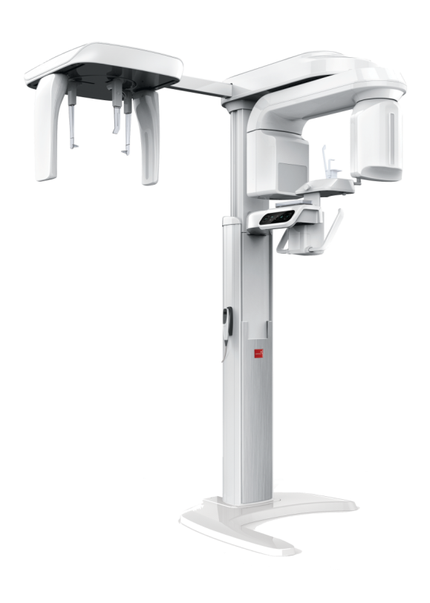
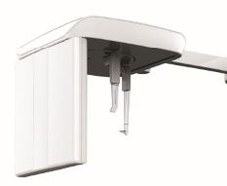
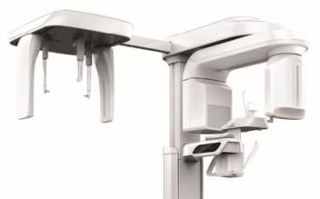
NEXT
Composition & Features of the Product
3 in 1 System
PaX-i3D is an advanced digital dental diagnostic system that incorporates PANO, CEPH, and 3D CT imaging capabilities into a single system.
OneShot Ceph
Scan Ceph
CT
PANO
Outstanding Image Processing Algorithm
UHD Mode : Acquire the PANO image with high resolution.
AF Mode : Acquire a more accurate panoramic image by auto-focusing the capturing area.
Metal Artifact Reduction : Acquire the image by minimizing the Metal Artifacts.
PANO / CT Sensor Auto Switching System
CEPH Multi-FOV : Minimizes X-ray dose by selecting the size of the FOV upon the image capturing area.

Slide 4

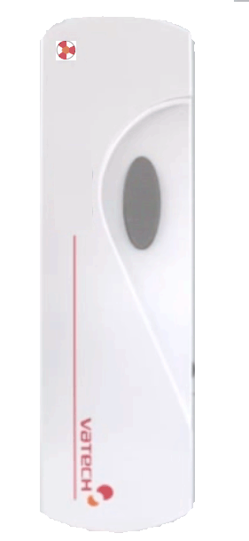

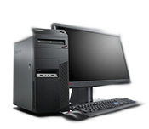
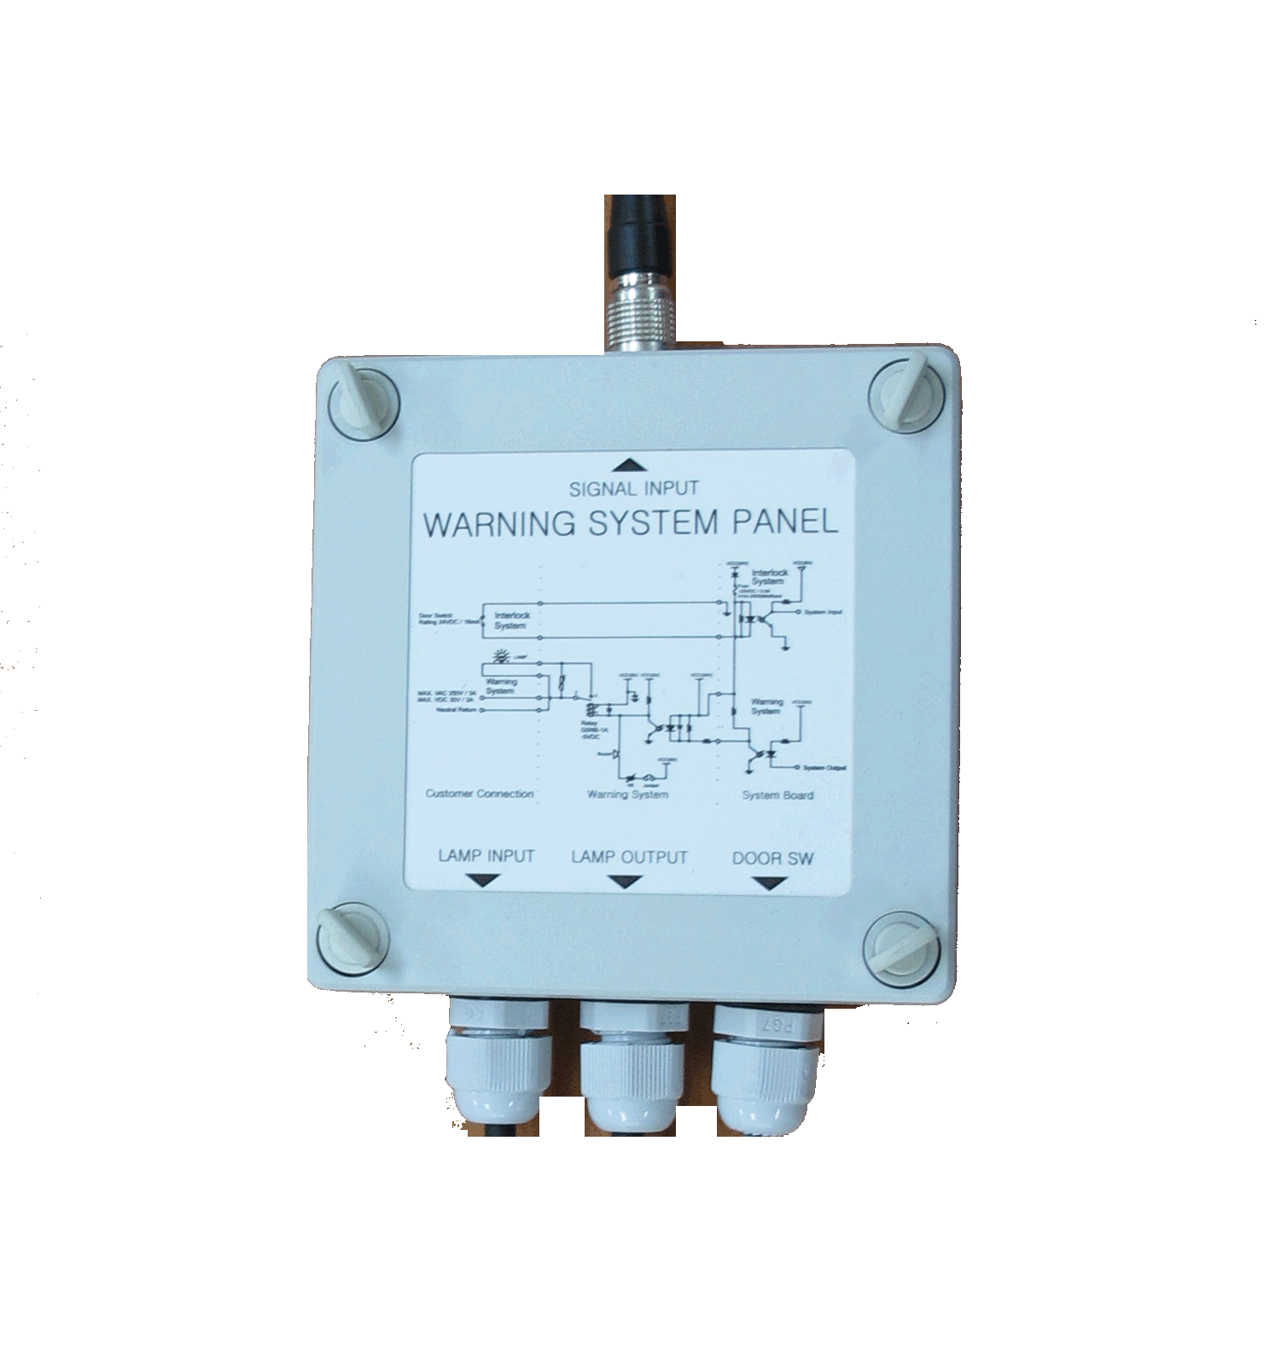
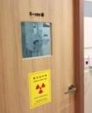
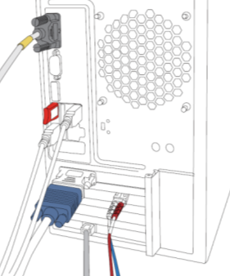

NEXT
Composition of Image Acquiring System
Console PC
Exposure Switch
Ethernet Cable(OneShot CEPH)
Fiber Optic Cable(10m)
RS-232 Serial Cable(10m)
Warning system panel(Optional)
RS-232
Warning Lamp
Door Interlock
Fiber Optic Cable
Ethernet Cable

Slide 5

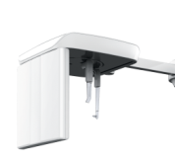
NEXT
Structure, Function and Accessories of the Product
Vertical Frame
Contains main control board and X-ray LED lamp.
CEPH Unit
Rotating Unit
Capture cephalometric image:
- Scan Type
- OneShot Type
Sensors and the X-ray Generator are embedded and rotates when capturing the PANO/CT image.
Handle Frame
Power switch and the components needed for patient positioning.
Base
Base is for the support of the whole unit (Optional).
Column Unit
Adjust height of the unit.

Slide 6
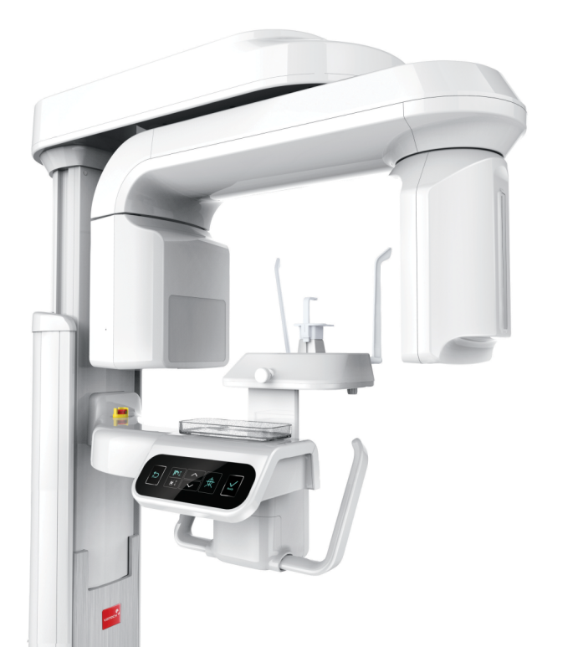
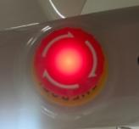
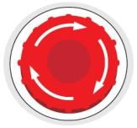
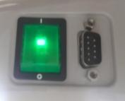
NEXT
Emergency Switch
The emergency switch is at the upper part of the handle frame.
If there is any emergency situation that may harm the patient or damage the device, press the emergency switch immediately to stop the operation of the device.
LED turns on and the operation stops when pressing the emergency button.
To reset the emergency stop switch, turn it clockwise until it pops up.
Power Switch
Power switch is at the bottom part of the handle frame..
After turning on the switch, wait until the device initializes completely. Then execute the capture software.
Power Switch
Column Up/Down
Switch Connector

Slide 7
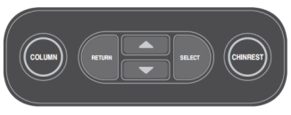
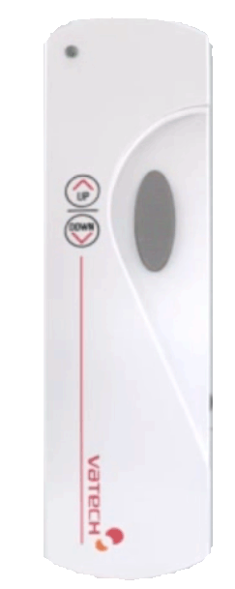
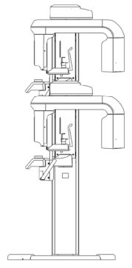
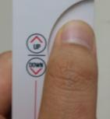
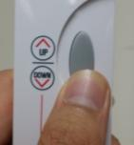
NEXT
HANDLE FRAME Button
1
2
3
4
5
① COLUMN : Adjust the height of the column when LED light is on.
② RETURN : Rotating unit returns to the initial position for the
next exposure.
③ / : Moves COLUMN/CHINREST up and down.
④ SELECT : COLUMN ↔ CHINREST mode button.
⑤ CHINREST : Adjust the height of the column when LED light is on.
Column Up/Down
By using the Column up/down button, control the height of the column and then proceed with patient positioning.
Column moves up by pressing the upper part of the button and
column moves down by pressing the bottom part of the button.

Slide 8
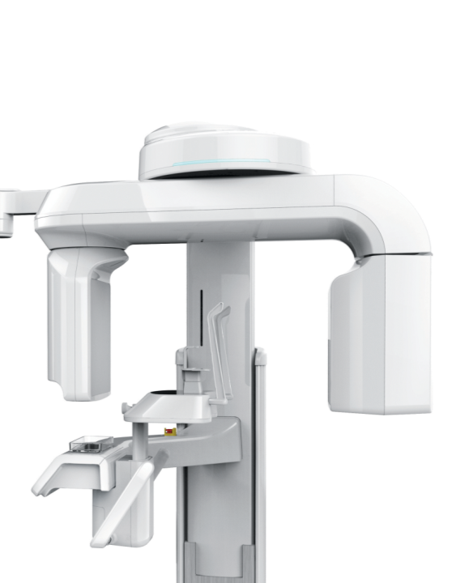
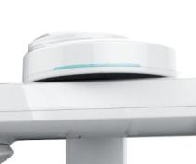
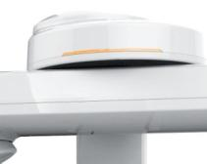

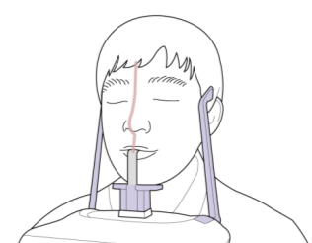
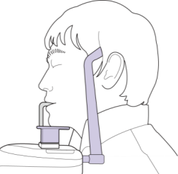
NEXT
X-ray LED Lamp
When power supplies the device, the green LED light turns on and the LED light turns orange during the X-ray exposure for image capturing.
Bite Block (Normal) & Temple Support
Place the head of the patient using the bite block and temple support for capturing the PANO image.

Slide 9
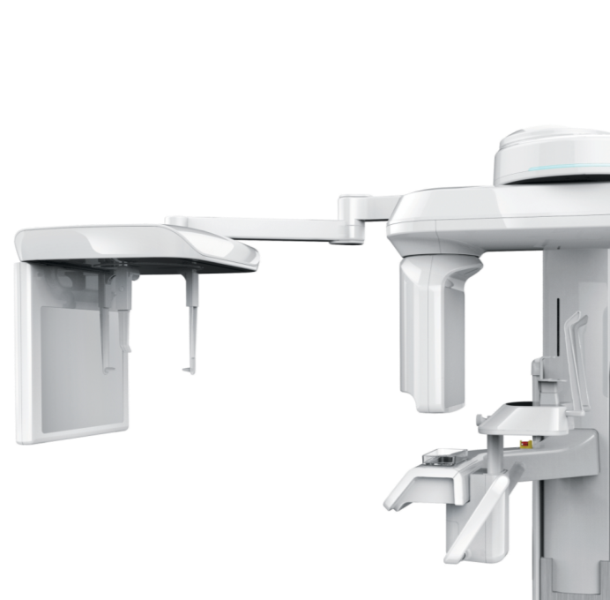
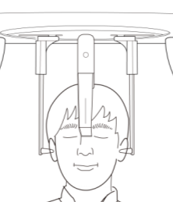
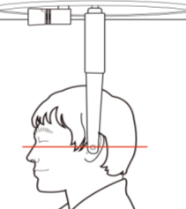
NEXT
Nasal Positioner & Ear Rods
These accessories allow the patient’s head to be stable when capturing the image in CEPH mode.

Slide 10
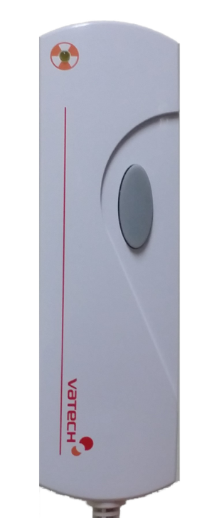
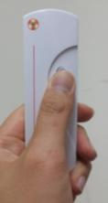
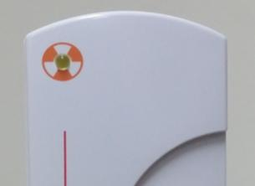
NEXT
Exposure Switch
This switch is for image capturing.
The exposure switch allows the operator to control image acquisition from outside of the X-Ray room. Press and hold the exposure switch down until the acquisition is complete.
Exposure
Indicator Light
Green : Ready
Orange: X-ray ON
Exposure Button
If the exposure switch is pressed, the color of the exposure indicator light turns orange. It indicates that there is X-ray exposure.

Slide 11
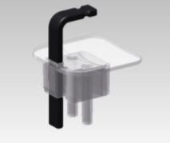
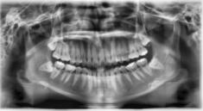
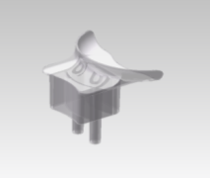
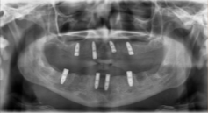
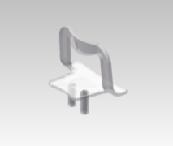
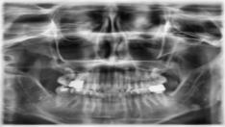
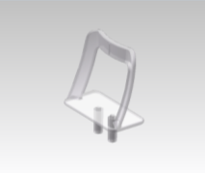
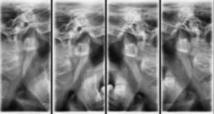
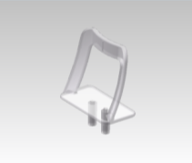
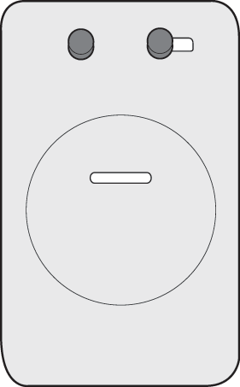
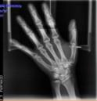
NEXT
Chin Support : Bite Block
Capture the basic PANO image.
Chin support : Edentulous
Chin support for edentulous patients.
Chin support: Sinus
Capture the sinus image.
Chin support: TMJ
Capture the TMJ Open/Close image.
Carpus Plate
Guide to capture the carpus in CEPH mode.

Slide 12

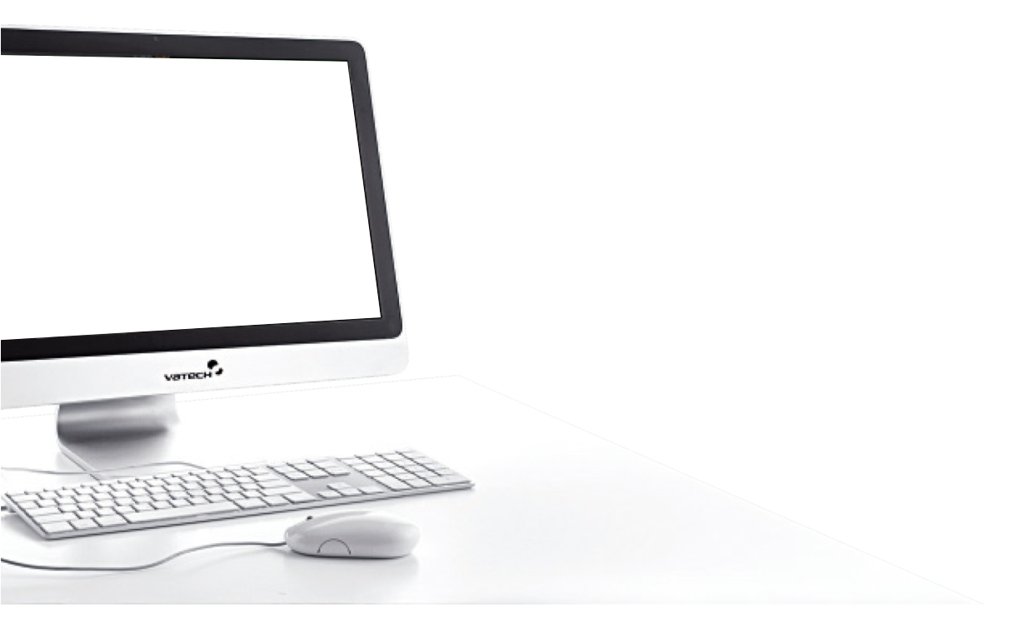
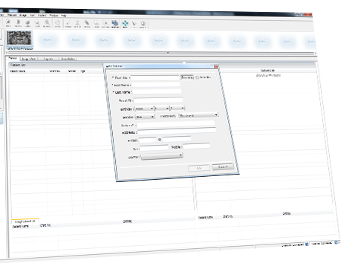
EasyDent V4
Patient Registration
NEXT

Slide 13


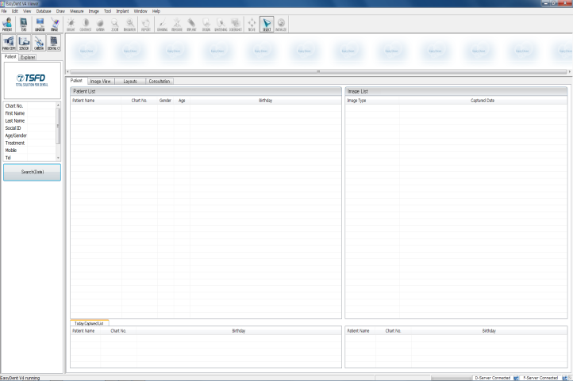



EasyDent V4
Execute the EasyDent V4 software by double clicking the EasyDent V4 icon.
EasyDent4
Viewer
Click x 2!!
NEXT

Slide 14


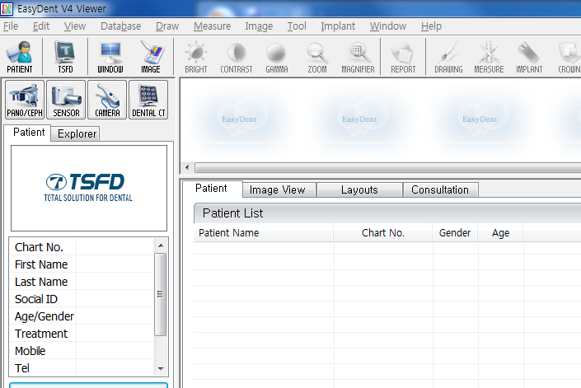

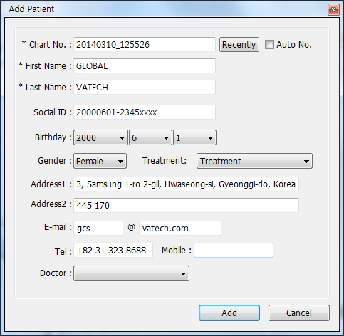

New Patient Registration
①
Click!!
Click the add patient icon. A window for registering a new patient will appear.
②
Click!!
Fill in patient information in the blanks and then click the “Add” button to complete patient registration.
NEXT

Slide 15
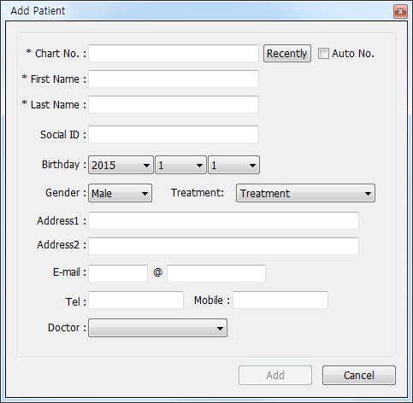
Chart No.*
First Name*
Enter the chart no. of the doctor.
The date registers automatically and you are able to cancel the set date from Settings. (Required)
Enter first name of patient.
You can change the notation order in Settings. (Required)
SSN
Last Name*
Enter last name of patient.
You can change the notation order in Settings. (Required)
Enter Social Security Number.
Date of Birth
Select the date of birth of patient.
Change the notation order from Settings.
Treatment
Select the state of treatment
Gender
Select the gender of patient.
Address
E-mail
Enter address information.
Enter information of the patient in each section.
Tel / Mobile
Enter telephone information.
NEXT

Slide 16

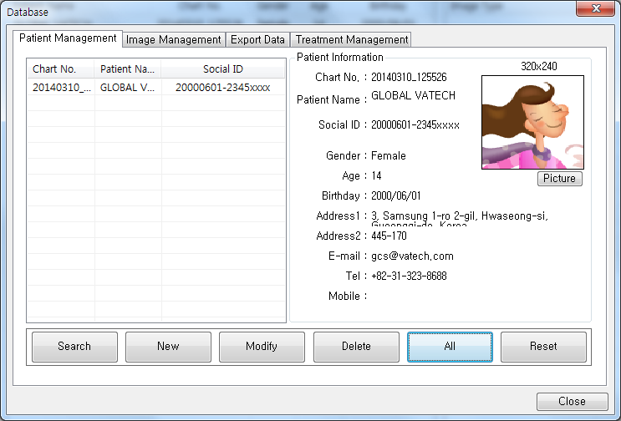
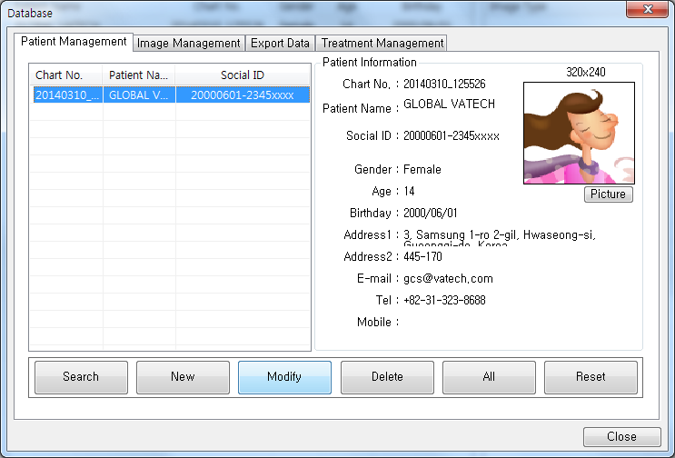



Update Patient Info.
③
Click!!
①
Click!!
④
Click!!
②
Click!!
After updating patient info., click the “Modify” button to complete the modification.
⑤
Click!!
NEXT

Slide 17





Patient Search(1/2)
②
Click!!
③
Click!!
④
Click!!
⑤
Click!!
①
Click!!
NEXT

Slide 18


Patient Search(2/2)
Double-click on Chart No., First Name or Last Name to display virtual keyboard.
①
Double Click!!
NEXT

Slide 19


NEXT
How To Capture the Image

Slide 20




NEXT
Execute Capture Software (PANO)
①
Click!!
Select the patient and then click Dental CT,
then the capture software will execute.

Slide 21

NEXT
Mode Display
Image Recon in Manual
Display the selected capture mode.
Reconstruct the image manually by clicking this button if an error occurs during the automatic image reconstruction.
X-ray Exposure
The color of the sign turns yellow when there is X-ray exposure.
Phantom
Capture
Settings
Close
Capture Status
& Image
Select
Modality
Display the capture status in real time and view the image in advance.
Select between
PANO and CEPH.
Patient
Info.
Capture
Mode
Display the chart no., name, gender, age and birthday of the patient.
Select the
capture mode of
PANO image.
DAP Value
Display the DAP
value.
Tube
Voltage/Current
Gender, Child and
Bone Density
Guidance Message
Display the various directions and guidance through voice over messages.
Display the basic value of patients tube voltage and current. Finely adjust when needed.
Display the information on the registered patient automatically. Edit when necessary.

Slide 22











NEXT
Image Capture Procedure - Standard Mode 1/7
① Click the buttons in the following order.
• PANO → HD(Optional) → Normal → Standard.
- AF function applied in PANO mode.
UHD : High resolution image - HD : High Definition Image
Normal : Normal Image
If the patient is under the age of 14, child arch is selected automatically.
This mode minimizes teeth overlapping in the image.
This arch is selected when capturing in the Bitewing mode.
The image is captured in the same order for the Right, Front, Left modes.
Click!!
② Click ‘CONFIRM’, then the device
automatically turns to patient positioning mode.
Click!!

Slide 23






NEXT
Image Capture Procedure - Standard Mode 2/7
③ When the device stops moving, put the Chin Support w/ Bite Block on the Chinrest.
Chin Support
w/ Bite Block
④ For safety, the patient (especially child or pregnant woman) should wear the lead apron.
Lead Apron
⑤ Patient should take off all jewelry and metallic objects such as hair pins, spectacles, dentures and orthodontic appliances
and place them on the accessory rack.

Slide 24




NEXT
Image Capture Procedure - Standard Mode 3/7
Hygiene Cover
⑥ Bring the patient to the device. Put a hygiene cover on the bite stick.
⑦ Adjust the temple supports so that they fit snugly on both sides of the patient’s head
using the temple support wheel.
Temple Support
Wheel
⑧ Bring the patient to the device.
⑨ Adjust the column height by pressing the column up/down switch (or button)
so that the patient ‘s chin reaches the chin rest.
Patient is to be positioned with the following procedures:
Grab the handle tightly with two hands.
Chest leans against the device
Move half a step forward..
Make sure the left and right shoulders remain level and the patient maintains this position.

Slide 25






NEXT
Image Capture Procedure - Standard Mode 4/7
⑧ Check if the patient has bit the groove correctly with his/her upper and
lower incisors.
⑨ Patient needs to be positioned correctly by checking the Mid-sagittal plane laser beam,
Frankfurt plane laser beam and the Canine laser beam .
Frankfurt Plane
Laser Beam
Canine Laser Beam
Mid-sagittal Plane
Laser Beam
Frankfurt Plane
Laser Beam
Adjusting Lever
Canine Laser Beam
Adjusting Lever
Mid-sagittal Plane
Lase Beam

Slide 26



NEXT
Image Capture Procedure - Standard Mode 5/7
⑩ Position patient’s head with the temple support wheel so his/her head does not move..
Temple Support
Wheel
⑪ Check the Mid-sagittal plane laser beam, Frankfurt plane laser beam
and Canine laser beam again.
Notify the following instructions to the patient.
Close eyes and remain still until the scanning is completed.
Keep tongue pressed against the palate and breathe through the nose.
Image capturing will begin.

Slide 27













NEXT
Image Capture Procedure - Standard Mode 6/7
⑪ Click the Ready button from the capture software.
Click!!
⑫ Follow the instructions from the Guidance Message window, then proceed image capturing by pressing the X-ray exposure switch.
When pressing the X-ray exposure switch, the orange LED light turns on. This means that the device is exposing the X-ray.

Slide 28






NEXT
Image Capture Procedure - Bitewing Mode
① Click the buttons in the following order.
• PANO -> HD-> Orthogonal -> Bitewing
UHD : High resolution image - HD : High Definition Image
Normal : Normal Image
If the patient is under the age of 14, child arch is selected automatically.
This mode minimizes teeth overlapping in the image.
Select this orthogonal arch when capturing the image in Bitewing mode.
In Bitewing Right, Bitewing Incisor and Bitewing Left modes, same procedure is done to capture images.
Click!!
② Click confirm and the device will turn to the
patient positioning mode.
◎ The next step is the same for the image capturing procedure in standard mode.
Click!!

Slide 29




NEXT
Image Capture Procedure - TMJ Mode 1/6
① Click the buttons in the following order.
• PANO -> HD/Normal -> TMJ LAT Open
UHD : High resolution image - HD : High Definition Image
Normal : Normal Image
Capture the image with the same procedure as in TMJ PA Open/Close mode.
* After completion of image acquisition in TMJ LAT Open mode, the mode switches automatically to TMJ LAT Close mode with the voice over instructions.
Click!!
② Click confirm and the device will turn to the patient positioning mode.
Click!!

Slide 30



NEXT
Image Capture Procedure - TMJ Mode 2/6
③ Mount the TMJ bite on the Chinrest and position the patient like the following image.
TMJ Bite
Mid-sagittal plane laser beam : vertical line through center of patient’s face
Frankfurt Laser Beam : superior tragus to infra-orbital rim
Canine Beam : corner of lip

Slide 31
NEXT
Image Capture Procedure - TMJ Mode 3/6
④ Fix the patient’s head with the temple support, so there is no movement.
Temple Support Wheel
⑤ Check the Mid-sagittal plane laser beam, Frankfurt plane laser beam and the Canine laser beam again.
Inform the patient of the following instructions:
Close eyes and remain still until the scanning is completed.
Keep your mouth wide open until the capturing is completed.
Notify to the patient in advance that the capturing will be done twice (Open/Close)
Image capturing will begin.
⑥ Click READY from the capture software.
Click!!

Slide 32







NEXT
Image Capture Procedure - TMJ Mode 4/6
⑦ Proceed image capturing by pressing the exposure switch shown in the instructions in the Guidance Message Window.
Click!!
Click!!
Click OK and the mode will be automatically switched
to LAT Close mode.

Slide 33





NEXT
Image Capture Procedure - TMJ Mode 5/6
⑧ Check the Mid-sagittal plane laser beam, Frankfurt plane laser beam and the Canine laser
beam again.
Notify these following instructions to the patient.
Close eyes and remain still until the scanning is completed.
Keep your mouth closed until the scanning is completed.
Image capturing will begin.
⑨ Click READY from the capture software.
Click!!
⑩ Proceed image capturing by pressing the exposure switch as shown in the instructions in the Guidance Message Window.

Slide 34





NEXT
Image Capture Procedure - TMJ Mode 6/6
⑬ After saving the acquired image, check whether it is saved in EasyDent V4 or not.
Click!!
TMJ LAT Closed
TMJ LAT Open

Slide 35


NEXT
Image Capture Procedure - Sinus Mode 1/4
① Click the buttons in the following order.
• PANO -> HD/Normal -> Sinus LAT
UHD : High resolution image - HD : High Definition Image
Normal : Normal Image
In Sinus PA mode, capture the image with the same procedure.
Click!!
② Click CONFIRM, then the device will turn to the patient positioning mode.
Click!!

Slide 36



NEXT
Image Capture Procedure - Sinus Mode 2/4
③ Mount the Sinus bite on the Chinrest and position the patient like the image below
Sinus Bite
Mid-sagittal plane laser beam : vertical line through center of patient’s face
Frankfurt Laser Beam : line through from tip of nose to top of ear
Canine Beam : corner of lip

Slide 37

NEXT
Image Capture Procedure - Sinus Mode 3/4
④ Position patient’s head with the temple support, so there is no movement.
Temple Support Wheel
⑤ Check the Mid-sagittal plane laser beam, Frankfurt plane laser beam and the Canine laser beam again.
Notify the following instructions to the patient.
Keep your eyes closed and do not move until the scanning is completed.
Image capturing will begin.
⑥ Click READY from the capture software.
Click!!

Slide 38









NEXT
Image Capture Procedure - Sinus Mode 4/4
⑦ Proceed image capturing by pressing the exposure switch, as the instructions are displayed
on the capture software screen.
⑧ After saving the acquired image, refresh patient to view captured image.
Click!!

Slide 39

NEXT
Execution of Capture Software (CEPH)
①
Click!!
Select the patient, and then click Dental Ct, capture software appears.

Slide 40










NEXT
Image Capture Procedure - Lateral Mode 1/6
① Click the buttons in the following order.
• CEPH → Lateral.
(Optional)
Scan Time : 12.9 Sec
Scan Time : 13.5 Sec
Click!!
② Click CONFIRM, then the device will turn
to the patient positioning mode.
In PA, SMV, Waters View and Carpus mode, capture the image with the same procedure.
Click!!

Slide 41







NEXT
Image Capture Procedure - Lateral Mode 2/6
③ If the device stops, widen the ear rods.
④ For safety, patient (especially child or pregnant woman) should wear the lead apron.
Lead Apron
⑤ Patient should take off all jewelry and metallic objects such as hair pins, spectacles, dentures and
orthodontic appliances and place them on the accessory rack.
Accessory Rack

Slide 42




NEXT
Image Capture Procedure - Lateral Mode 3/6
⑥ Bring the patient to the CEPH unit.
⑦ Adjust the height of the unit to suit the patient by pressing the column up/down button or switch (optional).

Slide 43




NEXT
Image Capture Procedure - Lateral Mode 4/6
⑧ Position the ear rods to fit along the patient’s ear canals and adjust the nasal positioner
⑨ Position the nasal positioner on the patient’s Nasion point.

Slide 44




NEXT
Image Capture Procedure - Lateral Mode 5/6
⑨ Patient’s Frankfurt Plane should be parallel to the floor.
⑩ Notify the following instructions to the patient.
Do not move and keep your mouth and eyes closed until the image capturing is completed.
Image capturing will begin.
⑪ Click READY from the capture software.
Click!!

Slide 45










NEXT
Image Capture Procedure - Lateral Mode 6/6
⑫ Proceed image capturing by pressing the exposure switch, as shown in the instructions in the Guidance Message Window.
⑬ After saving the acquired image, refresh patient to view captured image.
Click!!

Slide 46











Cephalometric Image Capture Procedure
(In PA Mode)
① Select the PA mode from the
capture software and then click
CONFIRM.
② Turn the ear rods 90°
clockwise from their initial
position.
③ Widen the distance
between the two ear
rods.
④ Fold the nasal positioner.
Click!!
⑦ After saving the acquired image,
check whether it is saved in
EzDent-i or not.
⑥ Click READY from the
capture software and proceed to
the image capture.
⑤ Ask the patient to stand upright
facing the sensor. Make sure
that the patient’s shoulders are
level and his/her neck is
relaxed.
NEXT

Slide 47




Cephalometric Image Capture Procedure
(In SMV Mode)
① Select the SMV mode from
the capture software and
click CONFIRM.
② Turn the ear rods 90°
clockwise from their
initial position.
③ Widen the distance
between the two ear
rods.
④ Fold the nasal positioner.
Click!!
⑦ After saving the acquired image,
check whether it is saved in
EzDent-i or not.
⑥ Click READY from the
capture software and proceed
the image capture.
⑤ Gently bend the patient’s head
back until his/her Frankfurt
plane is perpendicular to the
floor as shown in image above.
NEXT

Slide 48




Cephalometric Image Capture Procedure
(In Waters View Mode)
① Select the Waters View mode
from the capture software and
click CONFIRM.
② Turn the ear rods 90°
clockwise from their
initial position.
③ Widen the distance
between the two ear
rods.
④ Fold the nasal positioner
Click!!
⑦ After saving the acquired image,
check whether it is saved in
EzDent-i or not.
⑥ Click READY from the
capture software and proceed
the image capture.
⑤ Ask the patient to stand upright
facing the sensor and bend
his/her neck back about 35° - 40°.
NEXT

Slide 49





Cephalometric Image Capture Procedure
(In CARPUS Mode)
① Select the Carpus mode from
the capture software and
click CONFIRM.
② Turn the ear rods 90°
clockwise from their
initial position.
③ Slide the CARPUS
Plate onto the nasal
positioner.
④ Slide the locking bolt on
the CARPUS plate towards
the nasal positioner and
turn it to the left.
Click!!
⑦ After saving the acquired image,
check whether it is saved in
EzDent-i or not.
⑥ Click READY from the
capture software and proceed
the image capture.
⑤ Ask the patient to put his/her right
hand flat on the CARPUS plate.
NEXT

Slide 50

NEXT
Execution of Capture Software (CT)
①
Click!!
Select the patient, and then click the “DENTAL CT” button and capture software displays.

Slide 51


NEXT
Image Capture Procedure - Standard Mode (1/7)
① Click the buttons in the following order.
• CT FOV > Position > Select the Image Quality > Metal Mode
Select the size of the CT FOV(Field of View).
- The FOV size is determined by the CT sensor attached on the device.
Select the ROI to be captured under the VERTICAL POSITION.
- Mn(Mandible)
- Mx(Maxillary)
- Occl(Occlusal)
- TMJ(Temporomandibular Joint)
Select the ROI to be captured under the HORIZONTAL POSITION.
- Right, Center, Left
Select the image acquisition speed under High (24 s) or Standard (15 s).
Select either Standard or Application mode for voxel resolution.
Metal Artifact Reduction reduces scatter caused by metal reflection.
② Click CONFIRM, then the device will turn to the patient positioning mode.
Click!!

Slide 52
NEXT
Image Capture Procedure - Standard Mode (2/7)
③ When the device stops moving, put the Chin Support w/ Bite Block on the Chinrest.
Chin Support
w/ Bite Block
④ For safety, the patient (especially child or pregnant woman) should wear the lead apron.
Lead Apron
⑤ Patient should take off all jewelry and metallic objects such as hair pins, spectacles, dentures and orthodontic appliances
and place them on the accessory rack.

Slide 53

NEXT
Image Capture Procedure - Standard Mode (3/7)
Hygiene Cover
⑥ Bring the patient to the device. Put the hygiene cover on the bite stick.
⑦ Loosen the temple supports by turning the Temple Support Wheel .
Temple Support
Wheel
⑧ Bring the patient to the device.
⑨ Adjust the column height by pressing the column up/down switch (or button)
so that the patient’s chin reaches the chin rest.
Allow the patient to be positioned by following the procedures:
Grab the handle tightly with two hands.
Let the chest lean against the device.
Move half a step forward..
Left and right shoulders remain level and keep holding the position.

Slide 54




NEXT
Image Capture Procedure - Standard Mode (4/7)
⑧ Check if the patient has bit the groove correctly with his/her upper and lower
incisors.
⑨ First, align the Mid-sagittal, CT vertical laser beam and then align the CT horizontal laser beam
by adjusting the height of the chinrest.
CT vertical laser beam
Chin rest
Up/Down button
CT horizontal laser beam
CHINREST LED Light
Mid-sagittal Plane
laser beam

Slide 55
NEXT
Image Capture Procedure - Standard Mode (5/7)
⑩ Adjust the temple supports so they fit snugly on both sides of the patient’s head, using the temple support wheel.
Temple
Support
Wheel
⑪ Check the beam alignment again.
Notify the following instructions to the patient.
Close the eyes and remain still until the scanning is completed.
Image capturing will begin.

Slide 56




NEXT
Image Capture Procedure - Standard Mode (6/7)
⑫ Click READY from the capture software.
Click!!
⑬ Proceed image capturing by pressing the exposure switch as shown in the instructions in the Guidance Message Window.
Capturing Image
image reconstruction is in progress
Converting to DICOM file.
When pressing the X-ray exposure switch, the orange LED light turns on. This means that the device is exposing the X-ray.

Slide 57


NEXT
Image Capture Procedure - Standard Mode (7/7)
⑭ After saving the acquired image, refresh patient to view captured image.
Double click to view the CT scan in the Ez3D plus software.
①
Click!!

Slide 58
Product Management
NEXT

Slide 59

Emergency Treatment
If any problem occurs while operating the device, perform the corresponding troubleshooting measures outlined in the table below. If the problem persists, please contact customer service.
CASE #1. Device Not Operating
CAUSE | SOLUTION
Fail to supply power | Check the power cable and the connection status.
Problem in initializing | Initialize the device completely and then try to operate again.
Fail in communication between PC & Unit | Check the connection status of serial port(RS232) which connects the PC to the device.
CASE #2. X-ray Exposure Switch
CAUSE | SOLUTION
Without pressing the “Ready” button | Check if the unit is completely ready for image capturing from the capture software.
NEXT

Slide 60
Emergency Treatment
CASE #3. Problem in Image Capturing
CAUSE | SOLUTION
Fail in device initialization | Re-start to capture image after initialization of the unit. If this happens continuously, restart the unit and try again.
CASE #4. Problem in Patient Positioning – Laser Beam Off
CAUSE | SOLUTION
Exceed the time limit for patient positioning | Turn the laser beam on again and proceed with patient positioning. Click the laser beam button from the unit or capture software. Then three laser beams will turn on.
NEXT

Slide 61
Cleaning
Before cleaning the device, make sure that the power of the device has been turned
off completely and disconnect the power plug from the outlet.
▣ ATTENTION
  Please keep the device clean especially the parts where the patient is in contact with often such as the handle frame, chin support and the bite blocks.
  Do not use the spray cleaners or solvents from entering the device. It may cause damage to the electrical components.
  Do not use the abrasive liquids such as acetone, gas, or oil.
  These may cause corrosion of the device’s surface.
  Do not use cleaning products which contain silicon.
  It may cause damage to the electrical components.
NEXT

Slide 62
Cleaning
▣ HOW TO CLEAN
ACCESSORIES | HOW TO CLEAN
Bite Block | Before capturing the image of each patient, sterilize these accessories with alcohol and dry off with a soft cloth.
Temple Support
Chin Support (Normal / Sinus / TMJ)
All components that are in physical contact with the patient and the operator
PC and Peripheral Devices | Clean and keep them in good condition.
Outer part of the device | Wipe the outer part of the unit with a soft dry cloth everyday. Do not use any cleaners, bleaches or solvents for cleaning.
NEXT

Slide 63
Maintenance
Before inspection, ensure that the power of the device is off.
Do not open the cover of the device.
For the prevention of fire, please use the same fuse when replacing.
▣ ATTENTION
  Do not unplug the power plug by force.
  Do not keep the device and parts in a humid place.
  Keep the device and parts in an appropriate place to maintain them
  in good condition. They may be influenced by environmental factors such
  as temperature, lights, ventilation, dust, salt and so on.
  For items needed for image capturing, please arrange them and put them in proper places for the next image capturing.
  Please check the ground connection of the device.
  Do not try to fix the device(including wires and cables) by yourself.
  It may cause accidents and damage to the device.
NEXT

Slide 64
Maintenance
▣ Tasks for Maintenance
CHECK LIST | Period
Before using the device, ensure that the device is clean and ready for use. Also, check the cleanliness of the parts where the patient is in contact most often. | Daily
After using the device, make sure that the main power of the switch has been turned off. | Daily
Ensure that the device is firmly plugged into a power supply device which is available only for the device. | Daily
Ensure that the power plug of the device is not unusually over heated. | Daily
While pressing the exposure switch(during X-ray exposure), please make sure that the indicator light turns on properly and remains orange to indicate there is no problem. | Daily
Check the proper operation of the X-ray exposure switch. | Daily
Check the status of the power cable. Ensure that there are no scratches or damage. | Weekly
Ensure that there is no problem on the operation of the emergency button. Entire operation of the device should be stopped if the emergency button is pressed. | Weekly
Ensure that all the labels attached on the device are clearly visible. | Monthly
Ensure that the voice over messages are audible during X-ray exposure. | Monthly
NEXT

Slide 65
Disposing Unit
How To Handle & Dispose Material
Classification | Main Material | Reusable | Special Treatment Needed (Mandatory) | Hazardous Waste (Needs to be handled separately)
Frame & Outer Cover | Aluminum & Plastic | ●
Motors |  | ●
Circuit boards |  | ●
Cable & Transformer | Copper | ●
 | Iron | ●
 | Oil |  | ●
Packing | Wood | ●
 | Cardboard | ●
 | Paper | ●
X-Ray Tube |  |  |  | ●
Sensor Head | Please return this part to the manufacturer, Vatech.
Other Parts |  |  | ●
To reduce the environmental contamination, this dental x-ray device should be disposed by following the instructions. All parts and components which contain hazardous materials must be disposed in accordance with the disposal regulations.
Except the X-Ray tube, other parts are re-usable. (IEC 60601-1 6.8.2 j).
Please observe all regulations
relevant to the disposal of waste in
your country. For further
information regarding the device
disposal, please inquire to your
customer service center.
This dental X-ray device must
not be disposed of as regular
garbage.
Please clean, disinfect and sterilize
the device before dissembling
and disposing of its parts.

Slide 66
Thank you
FAQ

