Slide 1
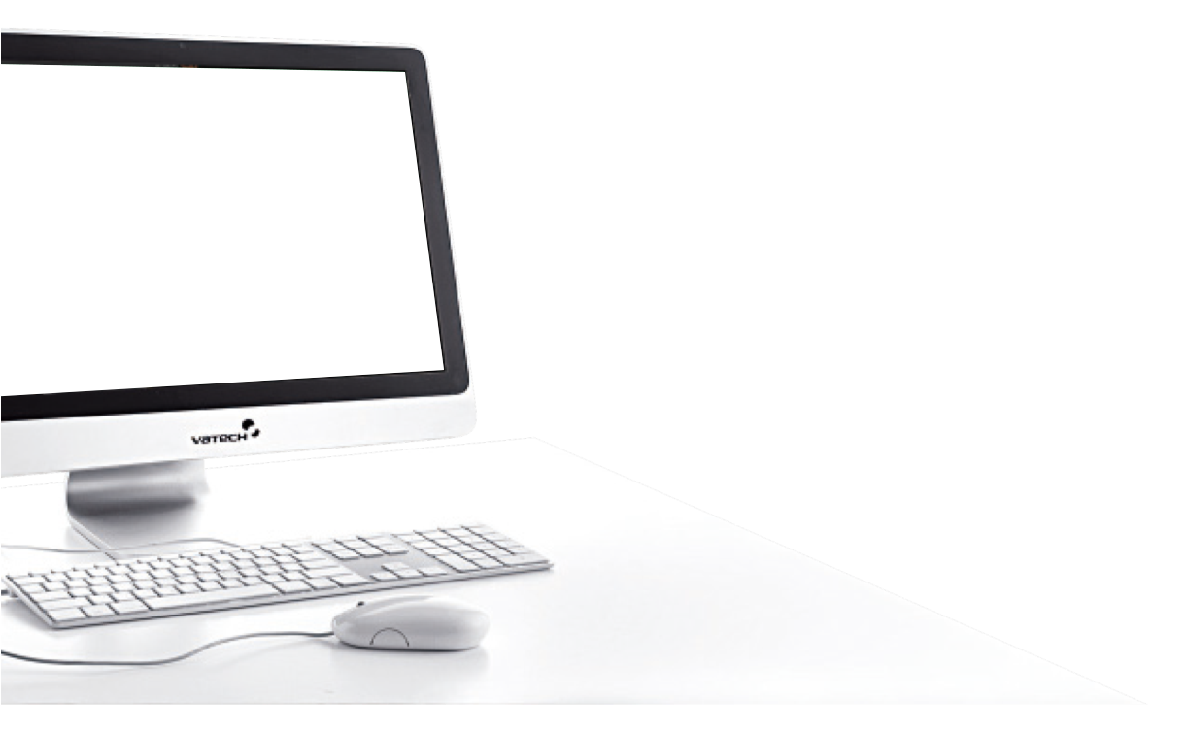
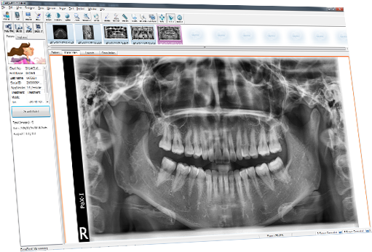
NEXT
EasyDent V4
Patient Registration
and Basic Usage Guide
Notes:
수진자 정보 관리
이미지 정보 관리
영상정보 내보내기
영상자료 가져오기
CT 영상 가져오기
도움말 EasyDent Viewer 버전 정보 보기, 업데이터 실행,

Slide 2

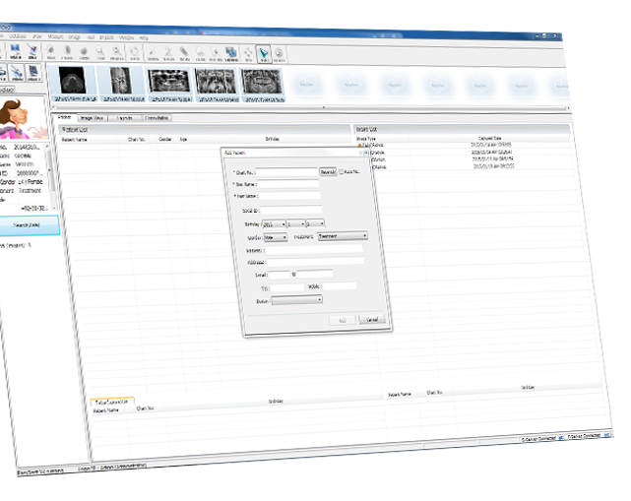




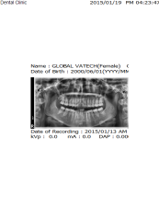


NEXT
Introduction to
EasyDent V4 &
Patient
Registration
Basic Usage
Guide
Print Report
& Send
E-mail
Settings

Slide 3

NEXT
EasyDent V4
Introduction to EasyDent V4
& Patient Registration

Slide 4

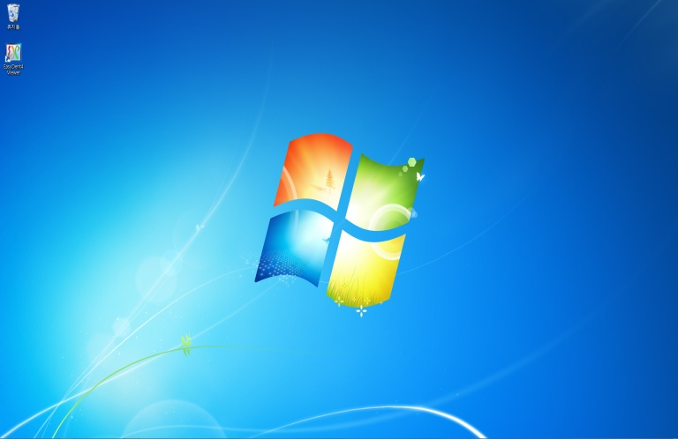
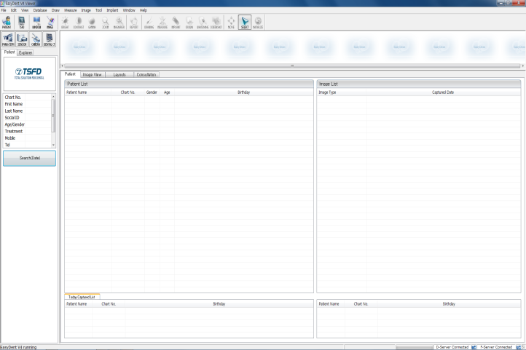



EasyDent V4
NEXT
Execute the EasyDent V4 software by double clicking the EasyDent V4 icon.
EasyDent4
Viewer
Click x 2!!

Slide 5
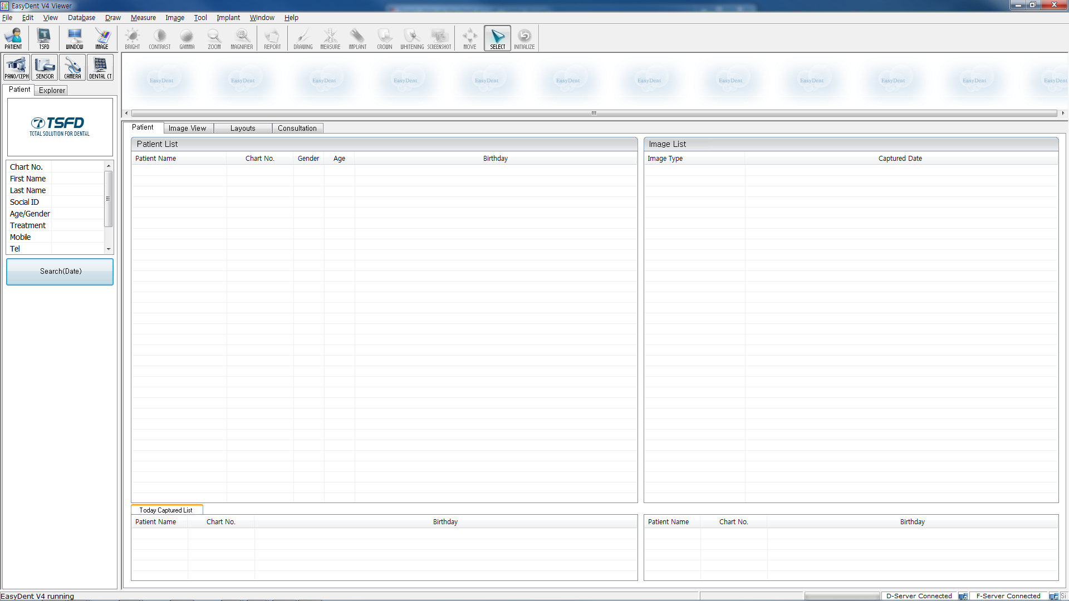
Main Screen
NEXT
Menu Bar
Function Tap
Tool Bar
All functions are divided and listed as items on the menu bar.
Allows quick selection of different viewing windows within EasyDent.
Icons created for quick usage of common tasks, such as image acquisition and search of patients and images etc.
Thumbnail
(Preview Window)
Displays thumbnails of captured images of the patient.
Patient List
Image List
Displays the list of patients.
Displays a list of images of the patient.
Patient
Information
Displays patient’s photo and personal information such as
chart number, name, age, and sex.
Network Status
Today’s Captured List
Displays list of all patients that have had a new image captured and added to their chart within the current work day. If you want to enable this function, click Today Captured List.

Slide 6
Menu Bar
NEXT
Menu Bar
All functions are divided and listed as items on the menu bar.
1
2
3
4
5
6
7
1
File, Edit, View : General Operating Instructions
2
Database : Database Management
3
Draw, Measure, Image : Image Processing
4
Tool : Special Tools
5
Implant : Implant Simulation
6
Window
7
Help : About EasyDent V4 Viewer, Configuration and Intra-Oral Sensor
Settings

Slide 7


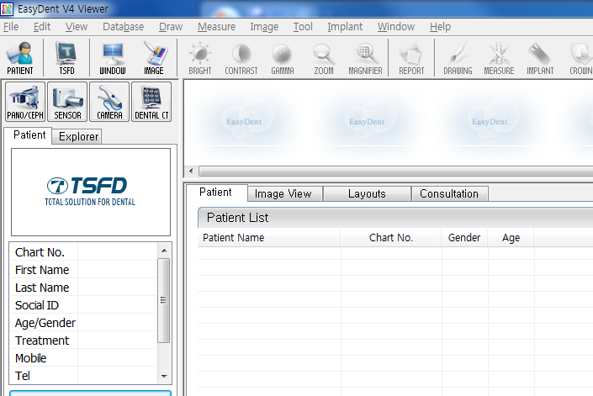

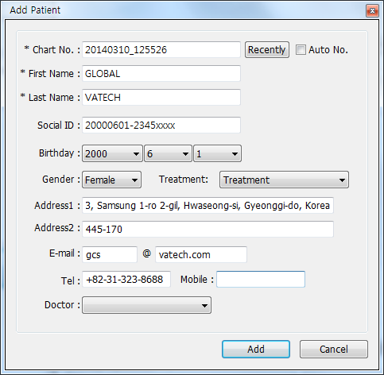

New Patient Registration
NEXT
①
Click!!
Click the add patient icon. A window for registering a new patient will appear.
②
Click!!
Fill in the patient information in the fields and then click the “Add” button to complete patient registration.

Slide 8
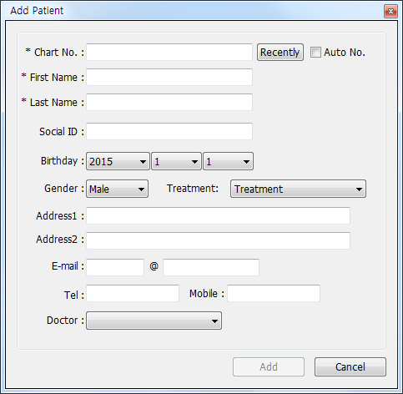
NEXT
Chart No.*
First Name*
Enter the chart no. of the doctor.
The date is being registered automatically and you are able to cancel the set date from Settings. (Required)
Enter the First name.
You can change the notation order from Settings. (Required)
Last Name*
SSN
Enter the Last name.
You can change the notation order from Settings. (Required)
Enter the citizen number from assigned country.
Date of Birth
Select the date of birth of the patient. Able to change the notation order from Settings.
Treatment
Select the state of treatment.
Gender
Select the gender of the patient.
Address
E-mail
Enter address information.
Enter information of the patient in each section.
Tel / Mobile
Enter telephone information.
* Required fields.

Slide 9

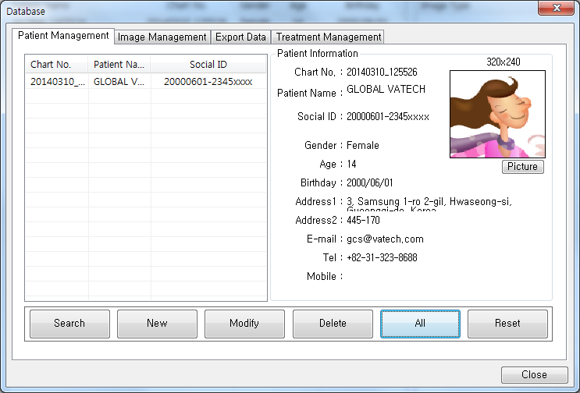
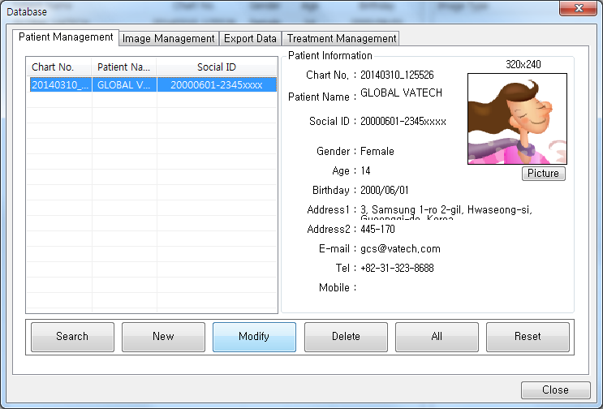
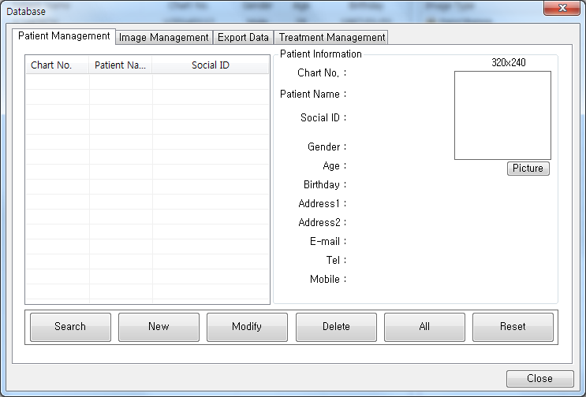
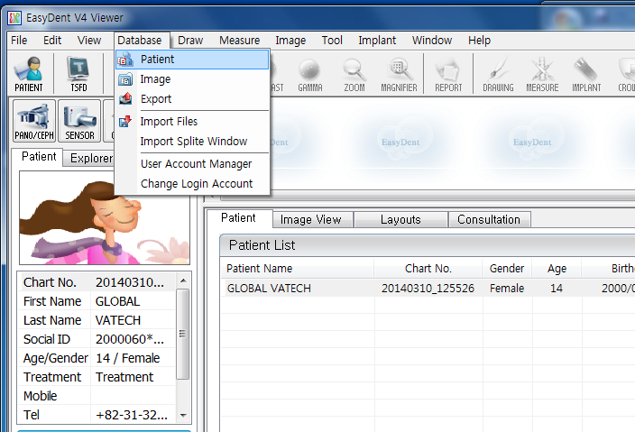
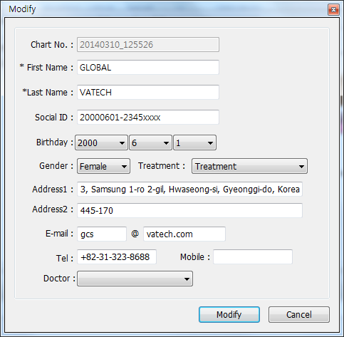
Modification of Patient Info.
NEXT
③
Click!!
①
Click!!
④
Click!!
②
Click!!
After updating patient info., click the “Modify” button to complete the modification.
⑤
Click!!
*administrative login required.

Slide 10

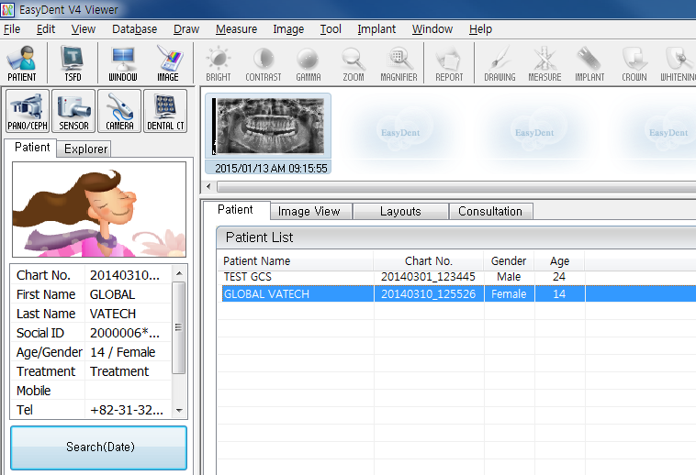
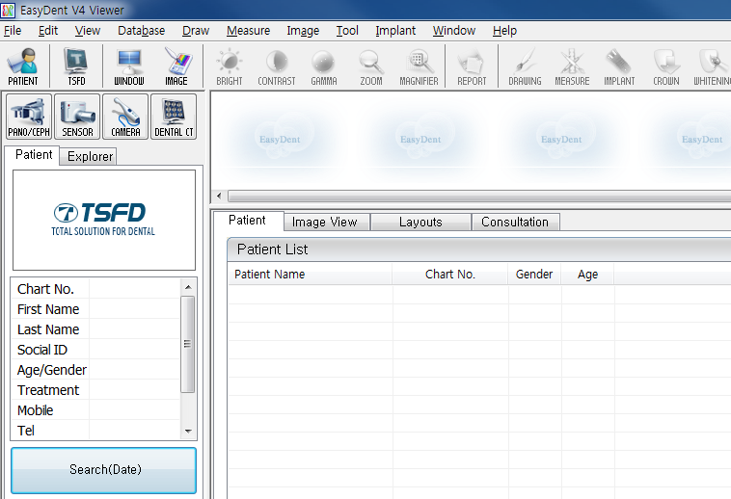
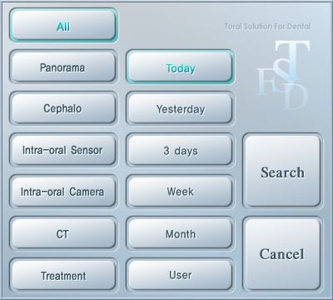
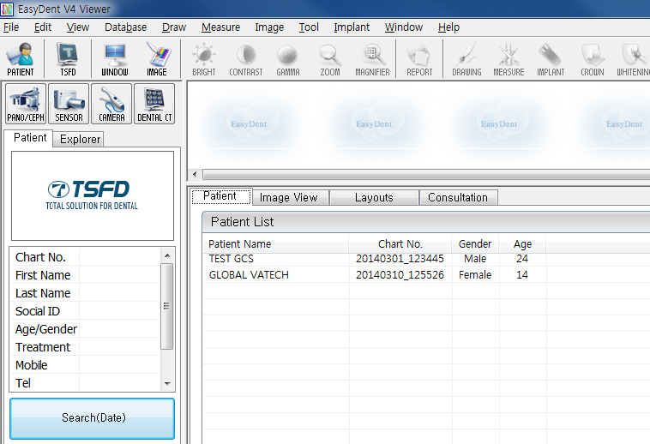
Patient Search(1/2)
NEXT
②
Click!!
③
Click!!
④
Click!!
⑤
Click!!
①
Click!!

Slide 11
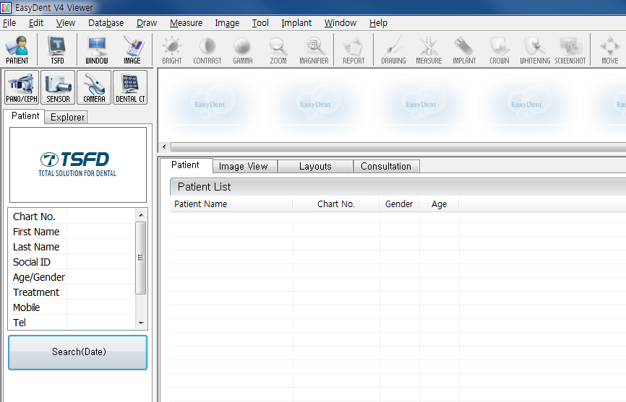
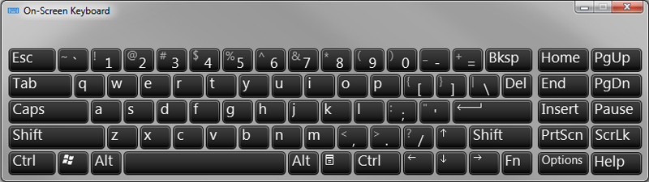
Patient Search(2/2)
NEXT
Double-click on Chart No., First Name or Last Name to display virtual keyboard.
①
Double Click!!

Slide 12
NEXT
EasyDent V4
Basic Guide

Slide 13
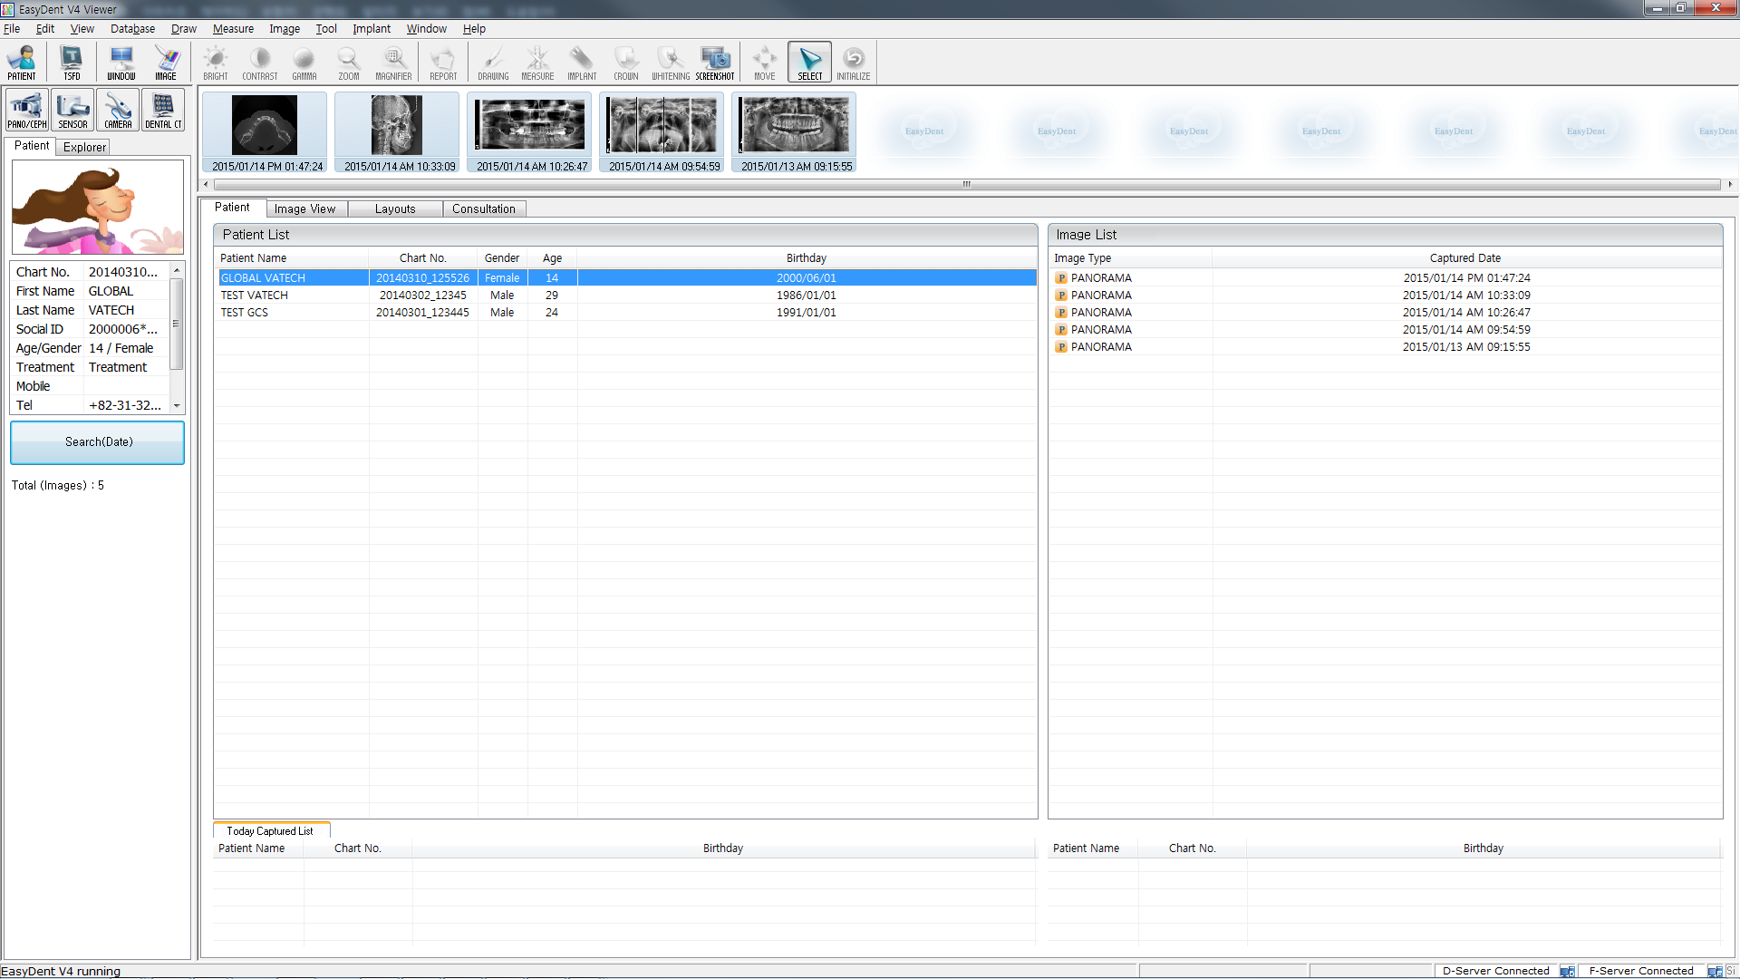
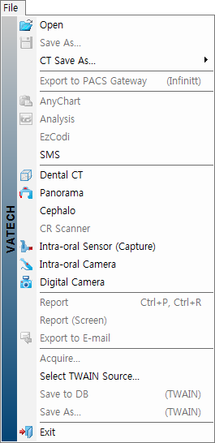

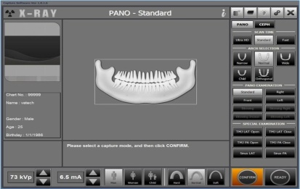
Image Capture – Extra Oral Equipment(1/2)
NEXT
① Select the Modality from the File tab on the menu bar.
Click to capture for 2D & 3D images.
*
Click to capture Panoramic image.
*
Click to capture Cephalometric image.
② The capture software will be executed.
*Panorama & Cephalo are for 2D devices only.

Slide 14
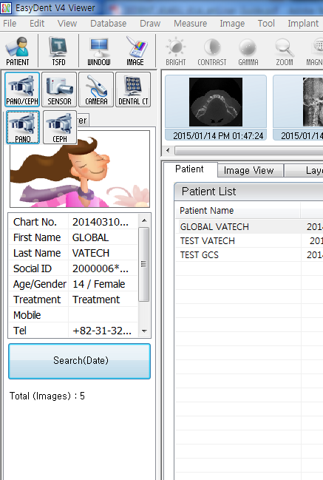

Image Capture – Extra Oral Equipment(2/2)
NEXT
① Select the Modality.
Click to capture Panoramic image.
Click!!
Click to capture Cephalometric image.
Click!!
Click to capture for 2D & 3D images.
Click!!
② The capture software will execute.

Slide 15


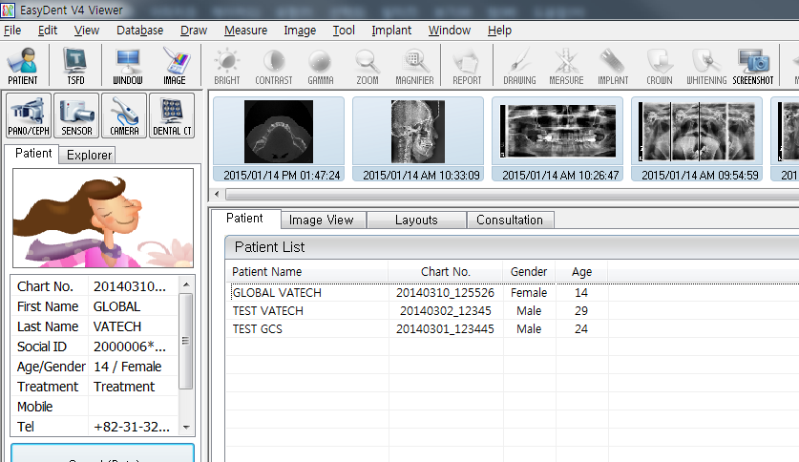
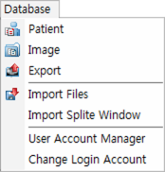
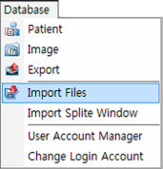
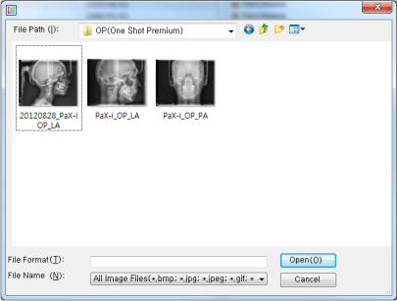
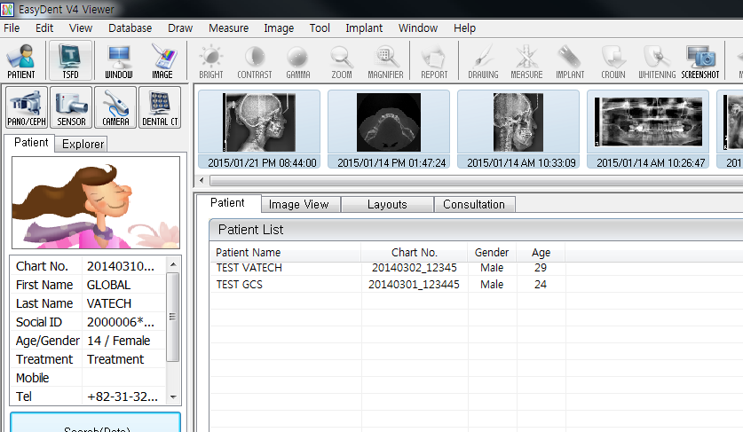
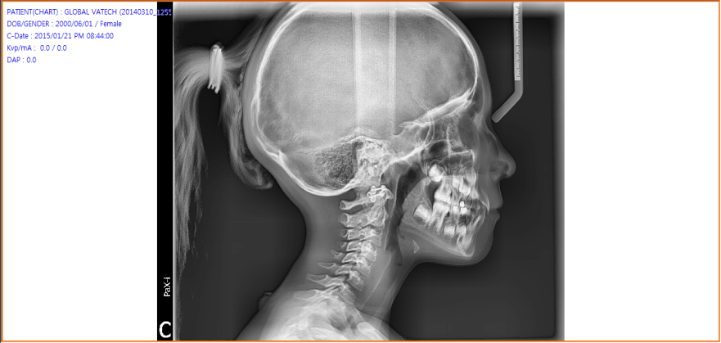
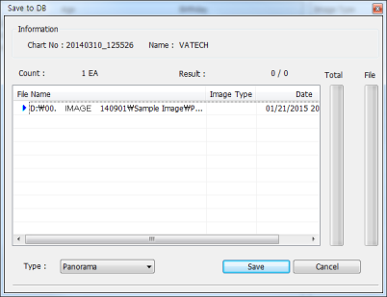
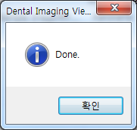
Import Image
NEXT
②
Click!!
③
Click!!
④
Click!!
①
Click!!
⑤
Click!!
⑧
Click!!
⑦
Click!!
⑥
Click!!

Slide 16

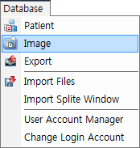
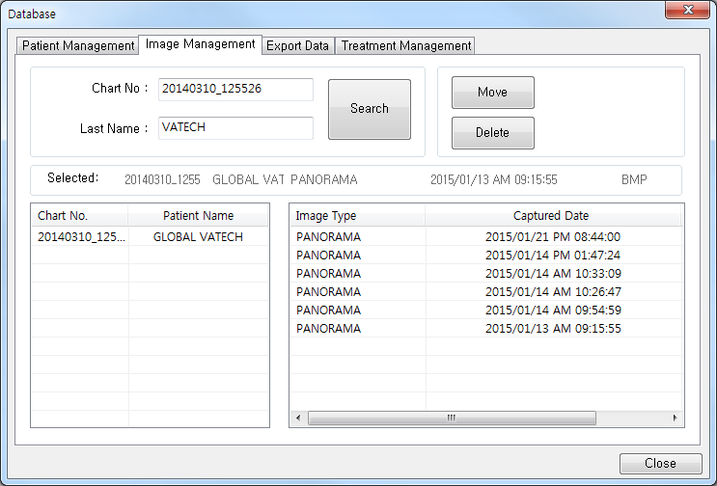
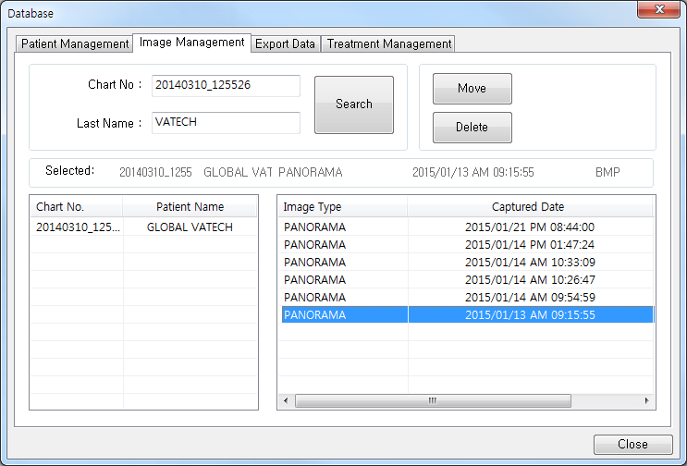
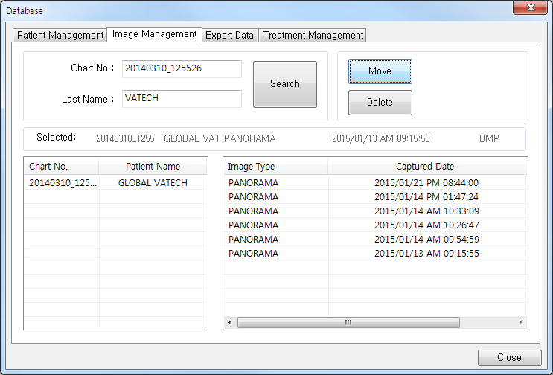
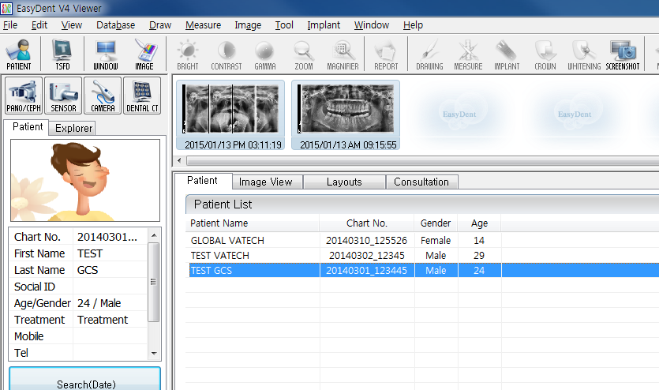
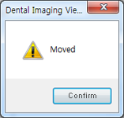
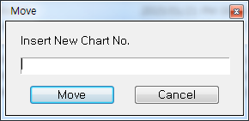
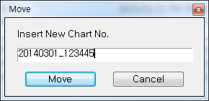
Image Transfer
NEXT
②
Click!!
③
Click!!
⑤
Click!!
①
Click!!
④
Click!!
⑧
⑥
Click!!
⑦
Click!!
Click!!
*administrative login required.

Slide 17
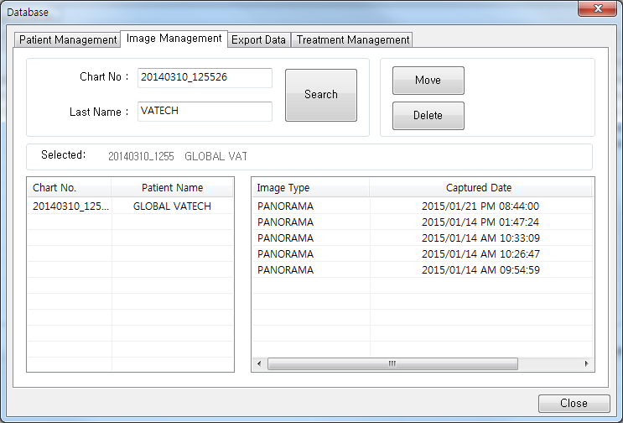
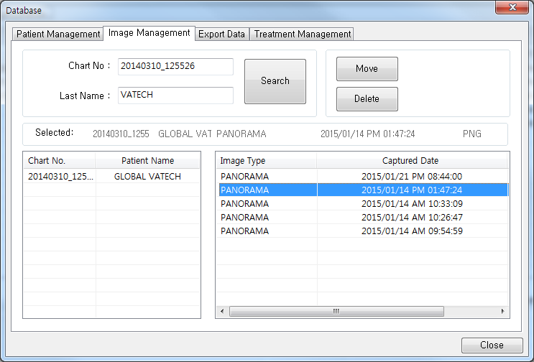
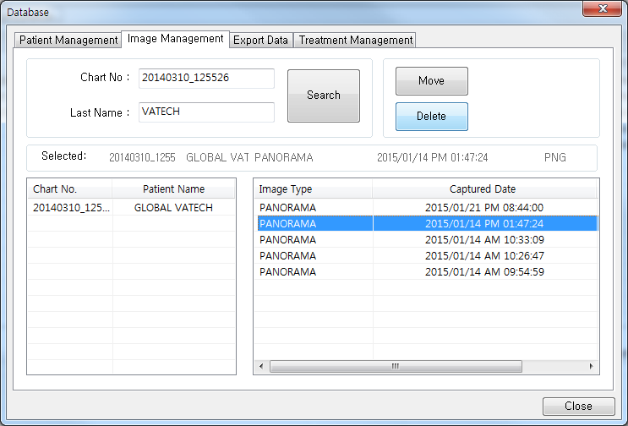
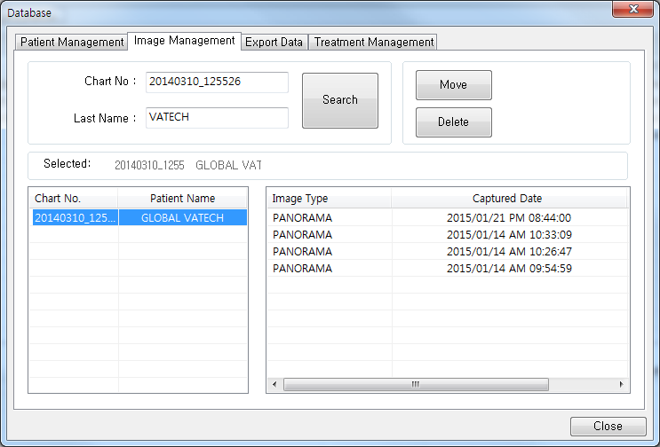
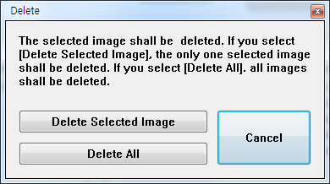
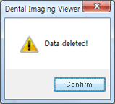
Image Delete
NEXT
②
Click!!
③
Click!!
⑤
Click!!
④
Click!!
①
Click!!
⑥
Click!!
⑦
Click!!
*administrative login required.

Slide 18

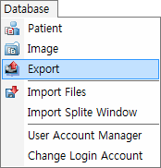
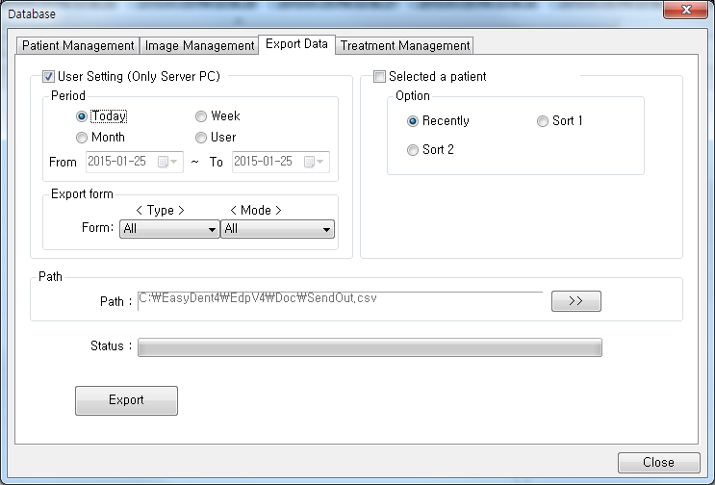
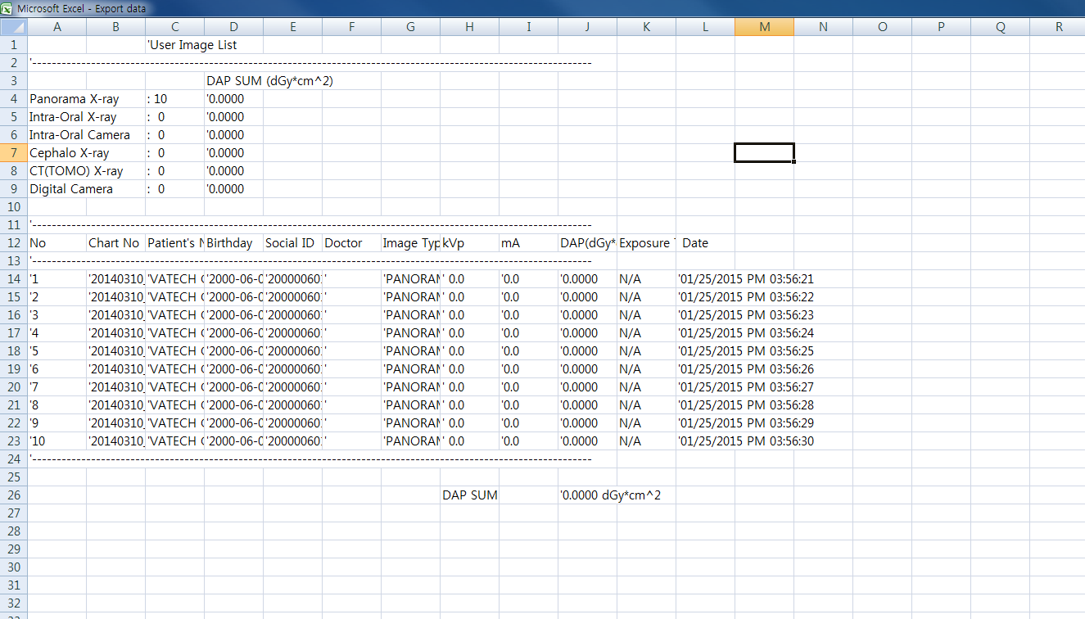


Export Data
NEXT
User Setting
The user can specify the storage capacity for
the image(s) to be exported.
①
Click!!
②
Click!!
Select a patient
Export the most recent images for the selected
patient into an Excel file.
Path
Shows the path where the exported patient data
will be saved.
③
Click!!
⑤
Click!!
Export Data
④
Click!!
*administrative login required.

Slide 19




CD/DVD Burning
NEXT
① Select mode option from the Select Burn Mode window.
①
Click!!
③
Click!!
② Insert a blank CD into the drive.
Then the CD Burner window will appear, as shown below. Click the Burn button.
②
Click!!
④
Click!!

Slide 20
NEXT
EasyDent V4
Print Report
& Send Email

Slide 21





Report Printing(1/2)
NEXT
① Using patient search, user selects the patient to
create a Report.
③
Click!!
②
Click!!
①
Click!!
⑤
Click!!
④
Click!!

Slide 22
Report Printing(2/2)
NEXT
Print Setup
Thumbnail
Choose selection and configuration of the printer.
Displays which patient’s images user wants to print.
Image Scale
The user can adjust the image scale to 1:1 or fit on screen.
Preview
Comment
Provides a preview of the images and contents that user want to print.
The user can write in the Title, Header, and Footer.
Date Type
The user can change the date format when printing.
Print
Prints report according to the user's settings.
Cancel
The user can cancel the printing process.

Slide 23

Export to E-mail(1/2)
NEXT
① Click File → Export to E-mail, a pop-up windows appear
as shown below.
③
Click!!
②
Click!!
①
Click!!
User can use the ‘Export to E-mail’ function only
if ‘Outlook’ is installed and configured on the computer.
④
Click!!

Slide 24


Export to E-mail(2/2)
NEXT
① Right-click the mouse and select Export to E-Mail.
②
Click!!
①
Click!!
Use the ‘Export to E-mail’ function only if ‘Outlook’ is installed and configured on the computer.
③
R-Click!!
④
Click!!

Slide 25
NEXT
EasyDent V4
Settings

Slide 26



Network Configuration(1/3)
NEXT
① Click Help → Configuration, a pop-up window appears
as shown below.
①
Click!!
Configure the DB Server’s IP address. It consists of
Local Host and Remote Host.
②
Click!!
Configure the File Server’s IP Address. It consists of
Local Host and Remote Host.
The Connection Time is the time that the server waits
in order to connect; while the Response Time is the
time taken for the reception of data after the
connection to the server is accomplished. The initial
value for each time is optimized, so we recommend
keeping the initial value, unless otherwise specified.

Slide 27







Network Configuration(2/3)
NEXT
When the DB and the File Servers are installed on
separate computers.
① Click on to the Remote Host section of the DB Server IP Address. Then, input the IP Address of the DB Server computer.
② Click on to the Remote Host section of the File Server IP Address. Then, input the IP
Address of the File Server computer.
①
Click!!
③ Click on the ‘Apply’ button.
②
Click!!
③
Click!!

Slide 28



Network Configuration(3/3)
NEXT
When the DB and the File Servers are installed on the same computer.
① Click on to the Remote Host section of the DB Server IP Address. Then, input the IP Address of the DB Server computer.
② Click on to the Remote Host section of the File Server IP Address. Then, input the IP Address of the File Server computer.
①
Click!!
③ Click on the ‘Apply’ button.
②
Click!!
③
Click!!

Slide 29

Configuration - Overlay
NEXT
Drawing
Choose the style of the line (Dotted, Thin, Medium, or Bold) and its color in the
Drawing Tools.
Measure
Select the style (Dotted, Thin, Medium, or Bold) and color of the line to be used in
the ‘Measuring Tools’.
Drawing
Choose the style of the line (Dotted, Thin, Medium, or Bold) and its color from the
Drawing Tools.
Implant
Choose the color of the Implant.

Slide 30

Configuration - Image Processing
NEXT
Image Setting
Saves the current Bright, Contrast and Gamma
levels. The default setting is Not in Use.
Another Image
Processing
Sets the current Coloring, Film Effect, Invert and Gray Scale image process.

Slide 31

Configuration - Default
NEXT
Setting Chart No.
Dual Monitor
Click ‘Use’ to set the length of the chart number.
Option to use dual monitors.
Language
Magnifier
Select preferred language.
Size / Ratio / Color.
Linkage.xml
-Birthday
Ratio on screen
Interface the patient’s information with a third-party program through
Linkage.xml.
Choose Intraoral Sensor’s proportion to the screen.
Scale of
preview window
Login Option
Options include ‘Use Login’, ‘Not Use Login’, or ‘Auto Login’ for user when executing EasyDent.
Start mode
Date & Time

Slide 32

Configuration - Program
NEXT
Select capture
mode for Dental CT
Choose the capture mode for dental CT Equipment.
Select dental
formula
Select capture
mode for Panorama
Choose a dental formula.
Choose the capture mode for panoramic equipment.
Software for
Analysis
Path for
TOMO Viewer
Select either EzCeph or OrthoVision, either program can be used for analyzing CEPH images.
Path for
CT Viewer
Enable
CR Scanner

Slide 33
Thank you
FAQ

