Slide 1
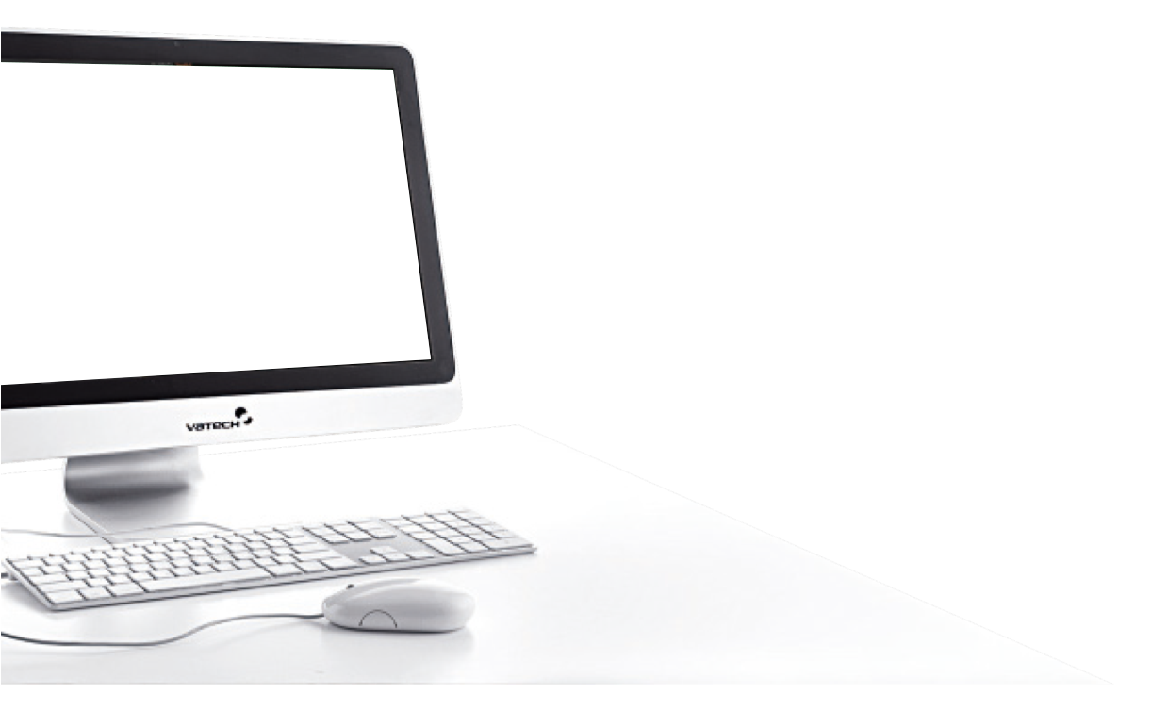
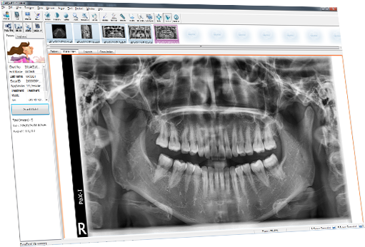
NEXT
EasyDent V4
How to Use the
Functions

Slide 2


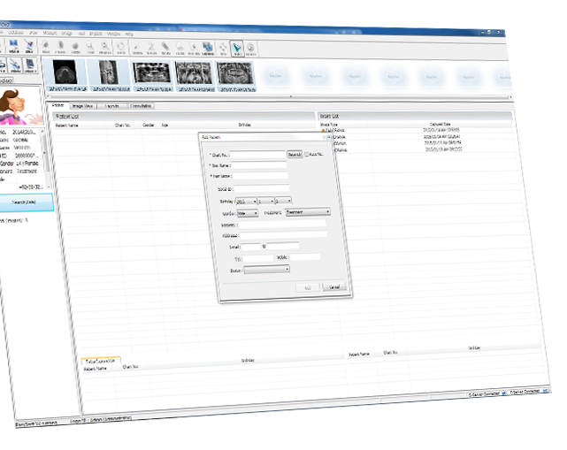




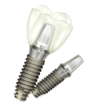

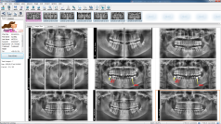
NEXT
Image Effects
Basic Tools
Usage
Implant
Simulation
Divide
a Window

Slide 3

NEXT
EasyDent V4
Image Effects

Slide 4
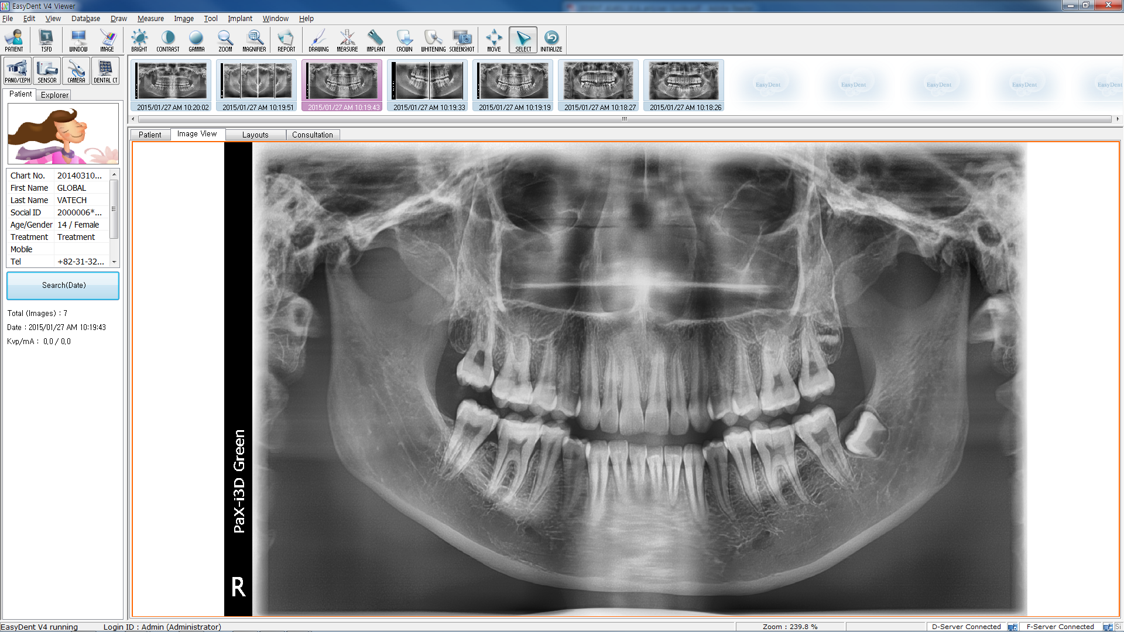
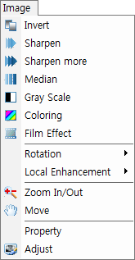
Image Tools
NEXT
Coloring
Convert the black and white image into a colored
one. Red signifies high density and blue signifies low
density.
Film Effect
Modify the image, so that it will have the effects of
the texture of developed film.
Rotation
Rotate the image in four different angles.
Invert
Soft tissue such as blood vessels and nerves that looked dark in the original image will appear with enhanced details.
Local
Enhancement
Highlight a specific area of an image and make it
easier to view.
Sharpen
Increase the contrast of the pixels to enhance the clarity of the image.
Zoom In/Out
Zoom in or out on an image.
Sharpen More
Sharpen 2-3 times more than Sharpen.
Move
Move the entire image.
Median
Eliminate noise in the image. It filters each pixel data in a way that each pixel takes the median of its surrounding pixels.
Property
Rotate the image and modify the tooth number.
Gray Scale
Control brightness in step levels, from white to black.
Adjust
Adjust the brightness, contrast, and gamma values for an image.

Slide 5


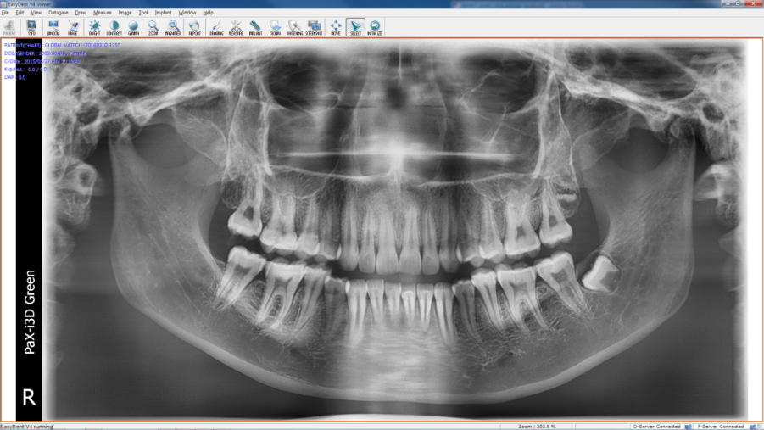
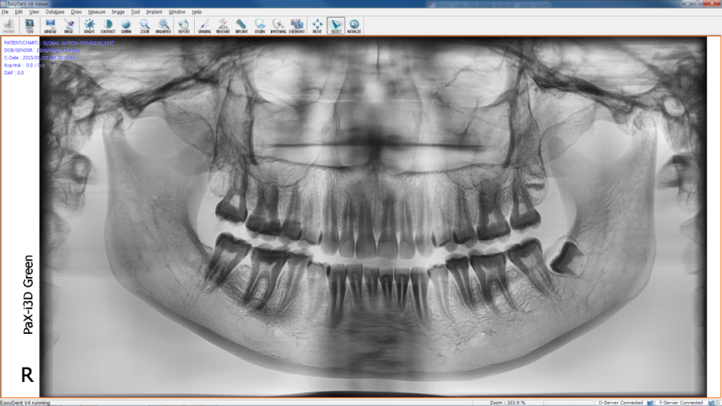

Image Tools - Invert
NEXT
①
Click!!

Slide 6
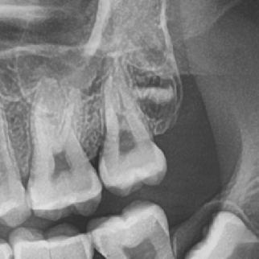
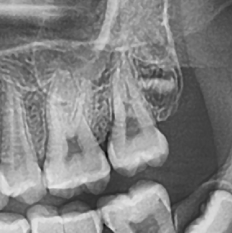


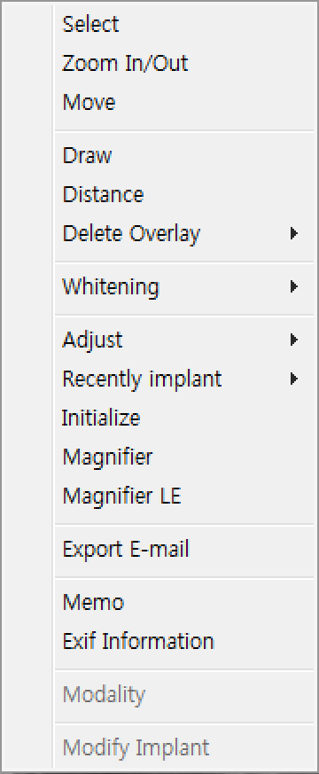
Image Tools - Sharpen
NEXT
Normal
Sharpen
①
Click!!
②
R-Click!!
③
Click!!

Slide 7


Image Tools – Sharpen More
NEXT
Normal
Sharpen
①
Click!!
②
R-Click!!
③
Click!!

Slide 8


Image Tools – Median
NEXT
Normal
Median
①
Click!!
②
R-Click!!
③
Click!!

Slide 9
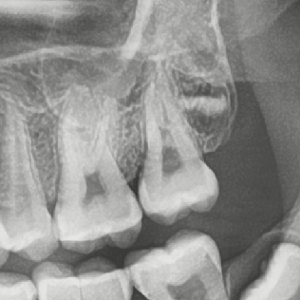

Image Tools – Gray Scale
NEXT
Normal
Gray Scale
①
Click!!
②
R-Click!!
③
Click!!

Slide 10
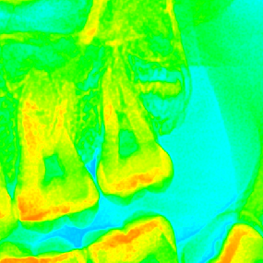

Image Tools – Coloring
NEXT
Normal
Coloring
①
Click!!
②
R-Click!!
③
Click!!

Slide 11
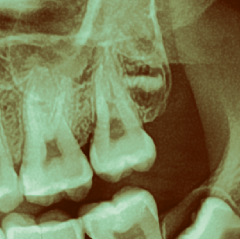

Image Tools – Film Effect
NEXT
Normal
Film Effect
①
Click!!
②
R-Click!!
③
Click!!

Slide 12
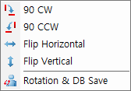
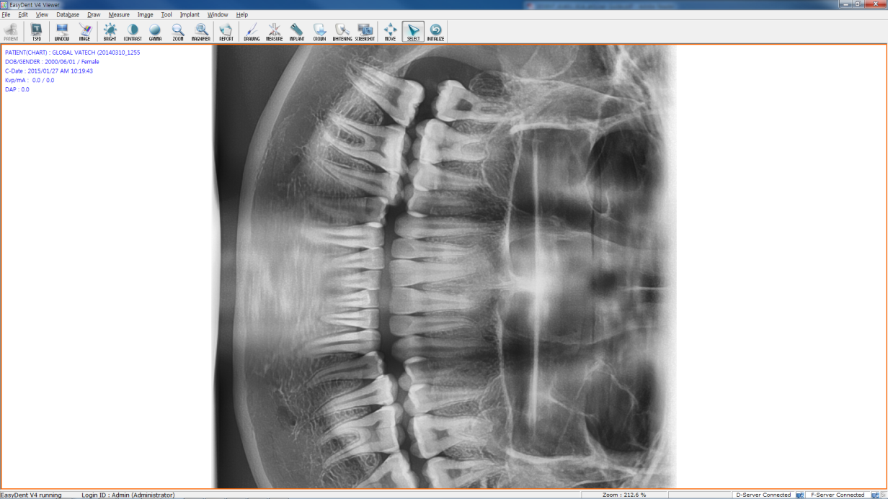
Image Tools – Rotation
NEXT
①
Click!!
②
Click!!
③
R-Click!!
④
Click!!

Slide 13

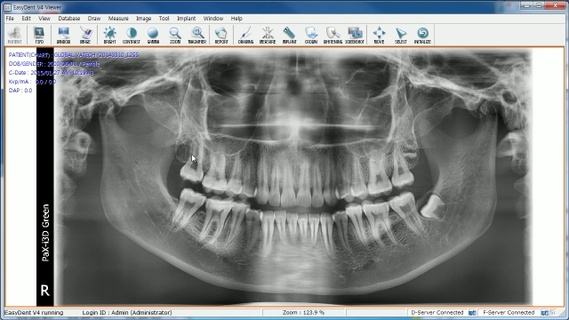
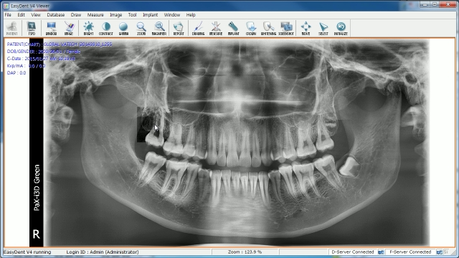
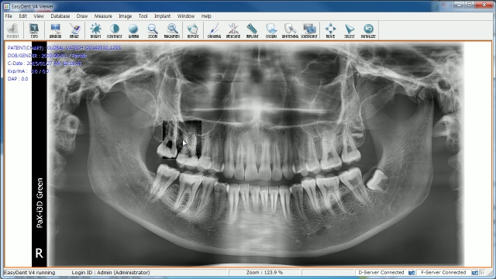

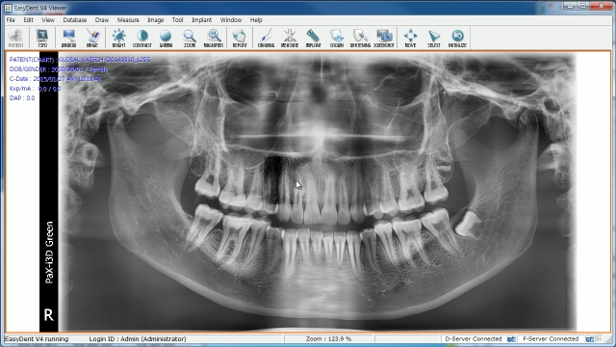
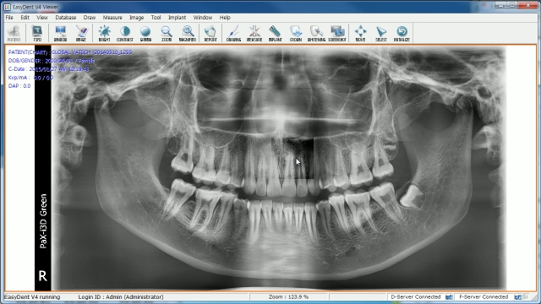
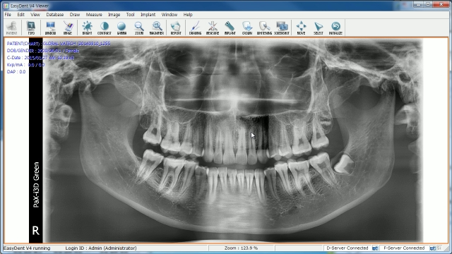

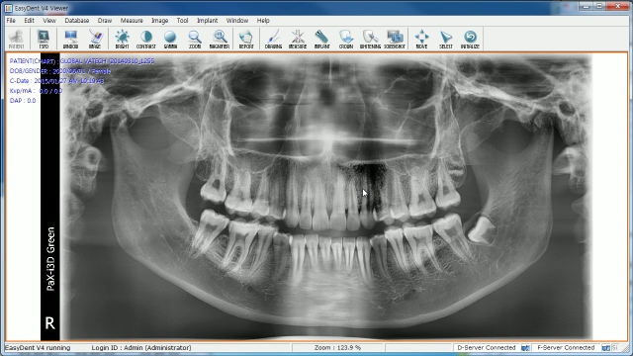



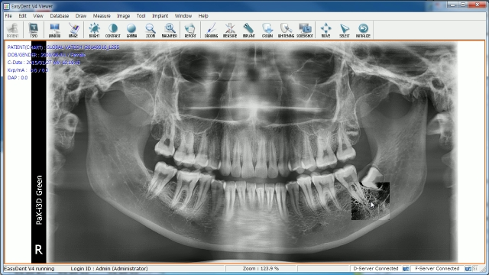

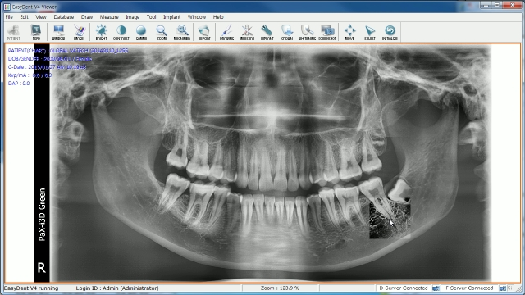




Image Tools – Local Enhancement
NEXT
①
Click!!
②
Click!!

Slide 14
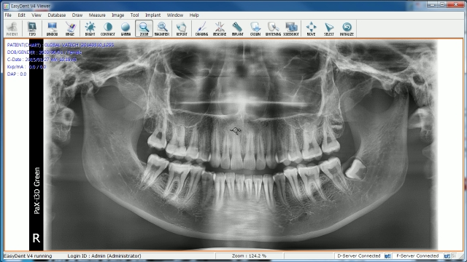
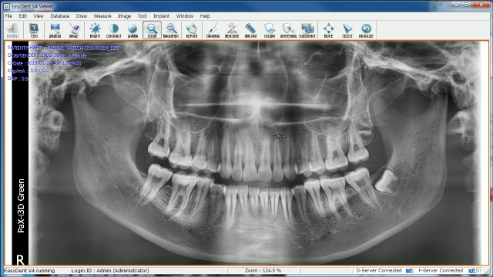
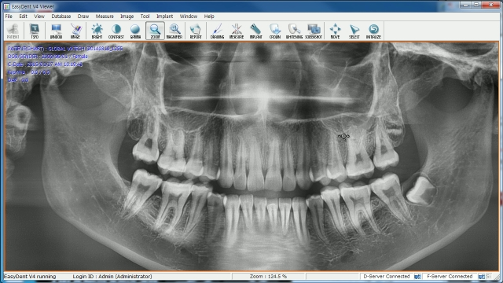
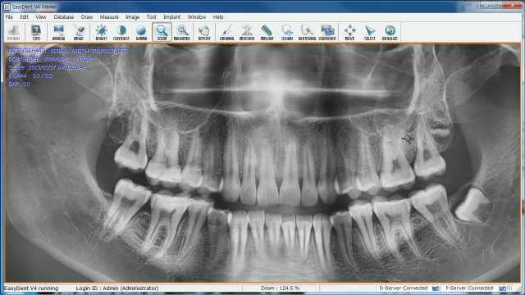
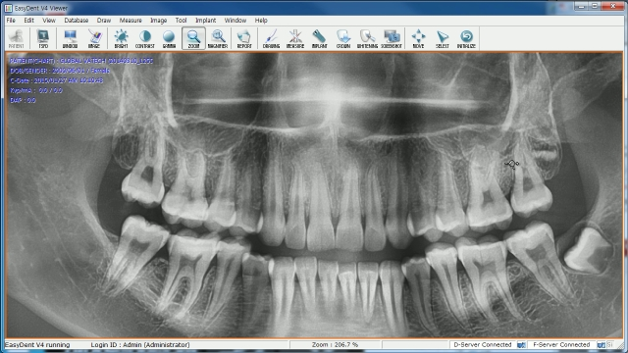

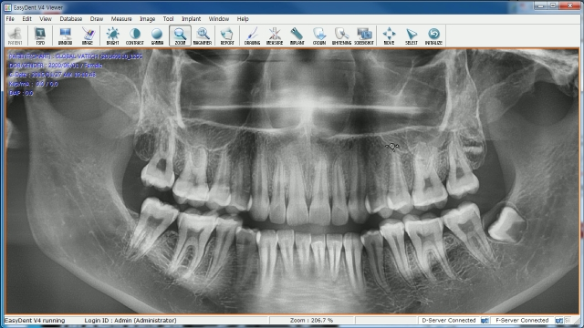
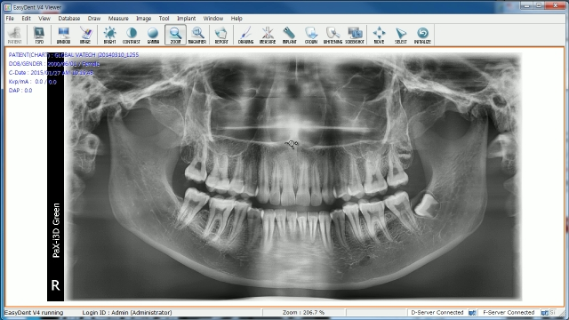
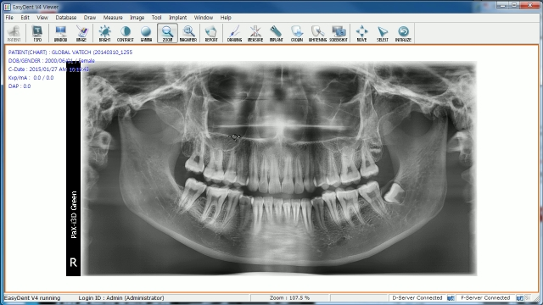






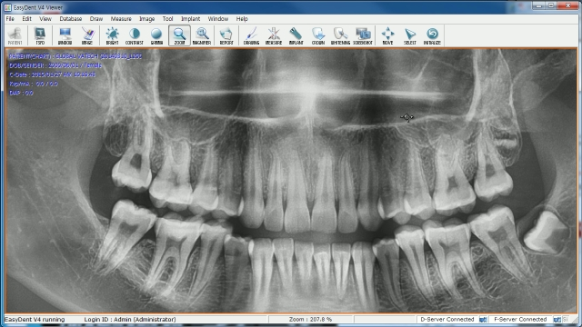
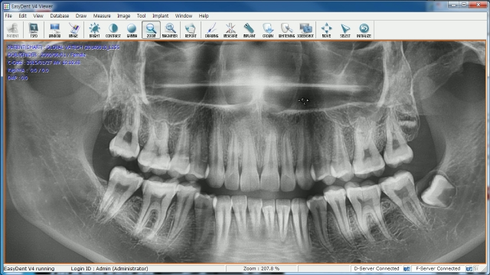
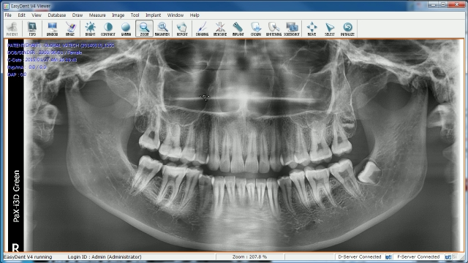
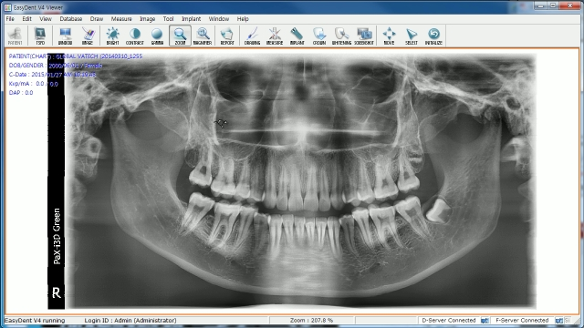
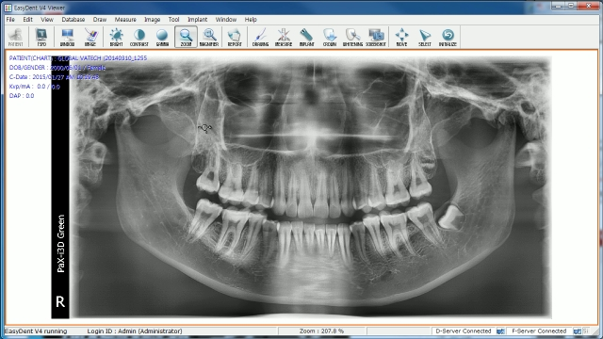
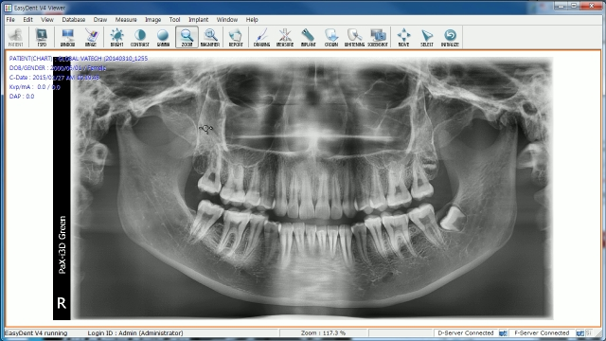
Image Tools – Zoom In/Out
NEXT
①
Click!!

Slide 15
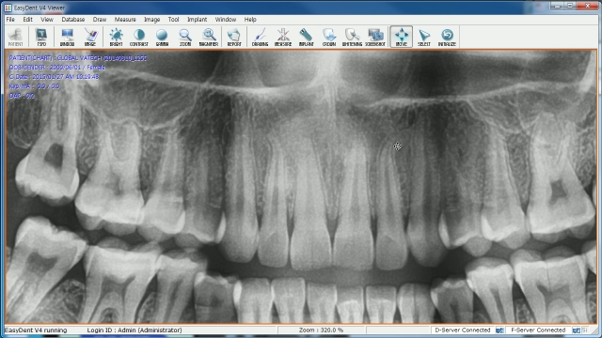

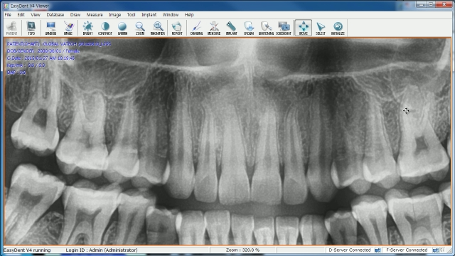
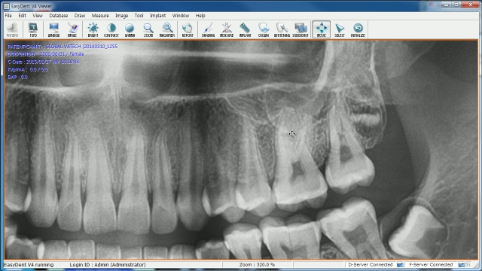
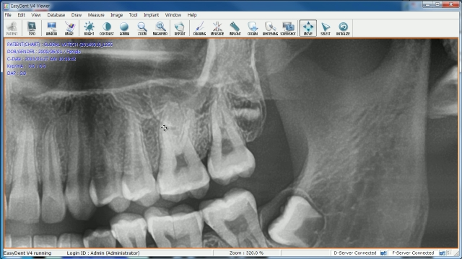
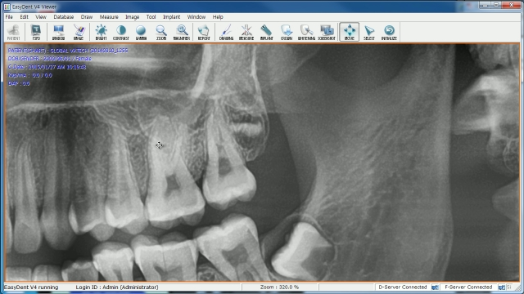


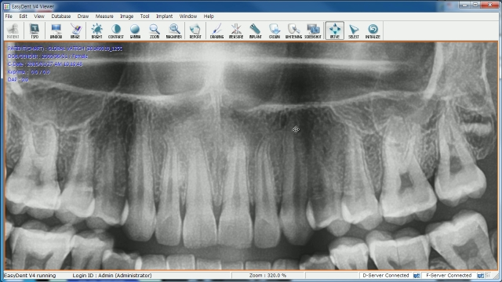
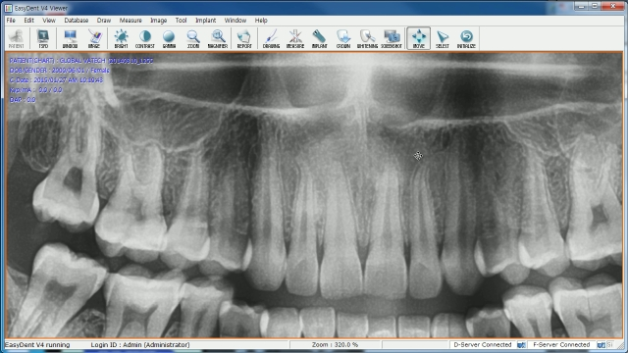


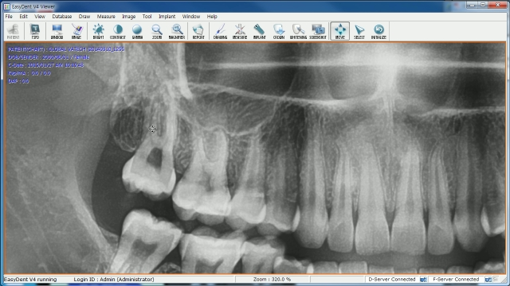
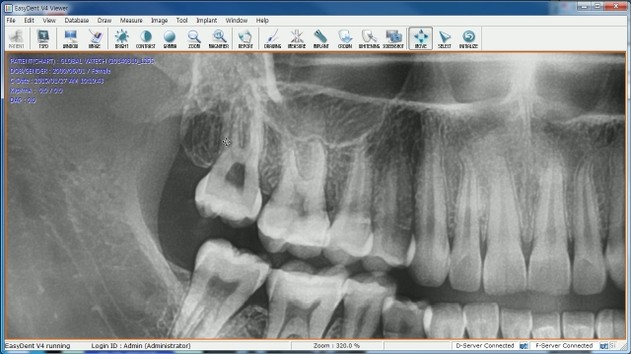
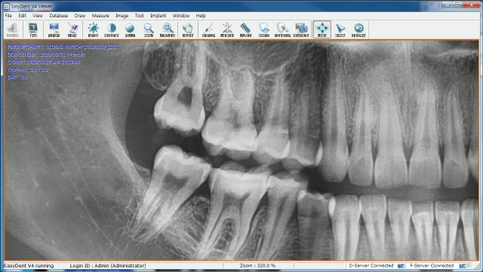




Image Tools – Move
NEXT
①
Click!!

Slide 16




































































Image Tools – Property
NEXT
①
Click!!

Slide 17



























































Image Tools – Adjust
NEXT
①
Click!!

Slide 18
NEXT
EasyDent V4
Basic Tools Usage

Slide 19


Draw Tool
NEXT
Free Draw
User can draw freely on the image.
Line
User can draw straight lines on the image.
Poly-Line
User can draw continuous lines on the image.
Rectangle
User can draw a rectangle on the image.
Ellipse
User can draw an elliptical shape on the image.
Color
Use can change the color of the line drawn on the image.
Style
User can change the style of lines used on the image using the Drawing Tool.
Delete
User can delete all drawings on the image using the Drawing Tool.

Slide 20



Draw Tool
Free Draw
Click Draw → Free Draw on the menu bar at the top of the EasyDent
Viewer window, or click on the DRAWING icon on the toolbar.
Then, draw freely on the image.
Line
To draw a line, click Draw → Line. Click and hold the mouse at the start
point. Drag and let go of mouse at the end point. Then a line segment appears
between two points.
Poly-Line
To draw a poly-line, click Draw → Poly-Line. Click the mouse
at the start point, followed by clicks at certain points, and then
double-click the mouse at the end point.

Slide 21



Draw Tool
Moving a Poly-Line
The poly-line drawn can be moved to a desired position. To move it,
follow the following steps.
① If a Poly-Line on the image is clicked, using the Select
Button on the toolbar, all the vertexes transform into a square.
② At this stage, click and drag the Poly-Line, to the desired location.
Rectangle
Click Draw → Rectangle on the menu bar at the top of the main
screen, and then draw any rectangular shape on the image.
Ellipse
Click on Draw → Ellipse, then draw an elliptical shape on the image.

Slide 22


Draw Tool
NEXT
Change the Color
Change the Line Style
① Click Draw → Color, then choose colors from Black,
White, Gray, Green, Blue, Yellow, and Red.
② Click User for more different colors other than the above-
mentioned ones. A full color palette will appear.
① Click Draw → Style, to change the types of lines used when drawing
on the image.
Click!!
Click!!

Slide 23



Draw Tool
NEXT
Delete All
① Click Draw → Color, choose colors from Black,
White, Gray, Green, Blue, Yellow, and Red.
② Click User for more different colors other than the above-
mentioned ones. A full color palette will appear.
Click!!

Slide 24

Draw Tool
NEXT
Delete All
① Click Draw → Color, choose colors from Black,
White, Gray, Green, Blue, Yellow, and Red.
② Click User for more different colors other than the above-
mentioned ones. A full color palette will appear.
③
R-Click!!
Click!!
Click!!

Slide 25

Measure Tool
NEXT
Distance
User can draw freely on the image.
Continuous Distance
User can measure the distance between several points, continuously.
Angle
User can measure the angle between two lines on the image.
Delete All
User can delete all measurements on the current image that was created using the Measure Tools.

Slide 26



Measure Tool
NEXT
Distance
Click Measure → Distance on the menu bar,
or the MEASURE icon on the toolbar.
Continuous Distance
① Click Measure → Continuous Distance.
② Click the mouse at the start point, followed by clicks at certain points,
and then double-click the mouse at the end point to acquire distance.
Angle
① Click Measure → Angle.
② You may measure any angle on any part of the image.
Click on three separate points to create an angle.

Slide 27


Measure Tool
NEXT
Delete All
Click on Measure → Delete All, all distances and angles added using the measuring tool will be deleted.
Click!!

Slide 28

Special Tool
NEXT
Magnifier
User can magnify a specific area of an image.
Whitening
This tool is available if an image was taken by an intraoral camera.
Magnifier LE
Magnifier LE (Local Enhancement) is a combination of the Magnifier and the Local Enhancement tools.
Snapshot
User can capture an image of the screen in 3 forms (Full Screen, Window, and Area).
Slide
Patient’s images are shown in the form of a presentation slide.
Crop Image
User can crop an intraoral sensor image.
Profile
User can measure the density of the teeth before an implant placement.
Dual Monitor
This tool is available only if a dual monitor setup is recognized in the operating system.
Layout Editor
This tool provides tools to create a user-defined layout.

Slide 29
















Special Tool - Magnifier
NEXT
①
Click!!

Slide 30





















Special Tool – Magnifier LE
NEXT
①
Click!!

Slide 31













































































Special Tool – Slide
NEXT
①
Click!!

Slide 32





Special Tool – Profile
NEXT
①
Click!!

Slide 33















































Special Tool – Whitening
NEXT
①
Click!!

Slide 34






Special Tool – Crop Image
NEXT
①
Click!!
Click!!
R-Click!!
Click!!
Click!!
Click!!

Slide 35
NEXT
EasyDent V4
Implant Simulation

Slide 36









































Implant Simulation
NEXT
①
Click!!
Delete All Implant
Delete All Implant Crown

Slide 37
NEXT
EasyDent V4
Divide a Window

Slide 38










Window
NEXT

Slide 39
Thank you
FAQ

